Slide 1
Steris Six Sigma Quality Improvement
Team B
OPS/571
May 10, 2018
Steve Garrett

Slide 2
Overview
Define Phase
Customers & Priorities
Project analysis
Improvement objectives
Customer needs & feedback
Productivity & quality
Problem statement
Critical-to-quality characteristics
Measure Phase
Metrics
Key internal processes
Current defects

Slide 3
Define Phase Customers & Priorities
Customers
Priorities
Hospitals
Surgery & Medical Facilities
Pharmaceutical Facilities
Laboratories
Quality Products
Sterilizers
Cleaners & detergents
Washing equipment
Quality Services
Equipment maintenance
Specialty services
Service parts
Notes:
Steris is the industry leader for sterilization and infection prevention products and services. It provides products and services for hospitals and surgery facilities all over the world. Other Steris Customers include pharmaceutical and research facilities that require sterile environments. Laboratories and research facilities make up a major part of Steris clientele as well.
Steris takes pride in its unparalleled products. Their equipment is different from other providers because of the unmatched quality. From sterilizers and washing equipment to the cleaners and detergents, Steris products ensure that its customers facilities and equipment remain sterile.
What sets Steris apart from its competitors is the quality of service it provides to every client. When a customer purchases a piece of equipment from Steris they expect a high quality product as well as timely and professional maintenance and service.

Slide 4
Define Phase Project analysis
Service request process
Response time
Technician maintenance/troubleshooting time
Service part retrieval time (if applicable)
Fix/Closeout of service request
Notes:
A suitable process for the six sigma quality improvement process would be the service request process. While Steris is known for its quality service, there is much room for improvement. Using six sigma, the time it takes to respond to and repair any discrepancy can be reduced if properly evaluated and implemented. It is important to break the process down piece by piece in order to identify shortfalls and address them accordingly. The process can be broken down into multiple steps:
Response time – How long does it take Steris to reply to a service call?
Technician maintenance/troubleshooting time – How long does it take service technicians to arrive on site and identify the problem?
Service part retrieval time – Does the corrective action require a new/serviceable component or part? How long will it take to receive the part that is needed?
Fix/Closeout of service request – How long does it take the technician to fix the discrepancy once all needed resources are “in-hand”?

Slide 5
Define Phase Improvement objectives
Preventative maintenance
Quality installation
Perioral servicing procedures
Reduce service request time
Response
Maintenance
Notes:
How can Steris improve its process through time and waste reduction?
Preventative maintenance
This requires quality service from the very beginning. When a technician installs a piece of equipment, the utmost care needs to go into the installation process in order to prevent any defects in the future. While things happen and equipment will break, many discrepancies can be prevented through careful assembly.
Another method of preventative maintenance is the implementation of periodical scheduled service actions. This come in the form of inspections, cleaning and lubrication of equipment. If properly serviced, equipment will last longer and the number of unexpected discrepancies can be reduced.
Reduce Service time
As discussed earlier, response time is crucial for both Steris and its clients. When a piece of equipment breaks, it is inconvenient for a customer and can cost the client revenue if not fixed in a timely manner. Ensuring that the issue is responded to immediately and technicians are dispatched in a timely manner is crucial.
The maintenance aspect of the service request involves communicating with the customer, identifying the specific issue through troubleshooting and fixing the discrepancy in a timely manner

Slide 6
Define Phase Customer needs and feedback
Reliable equipment
Efficient service time
Quality customer service
Notes:
Customers face challenging tasks of ensuring quality disinfection and sterilization processes mandated by the Joint Commission, American Health Association, the FDA, and many other regulatory bodies. Customers face an already difficult task of ensuring their surgeons are being given sterile instruments, properly wrapped, and ready for use at the time of need, and because of these requirements, uptime of disinfecting and sterilizing equipment is critical.
Reliability of equipment, minimal downtime for service and enhancing the customer experience is the aim of STERIS. The company is continually innovating its internal processes and setting tighter metrics to be met to encourage service and sales teams to perform at its best, but without adequate support from field support teams, the field would not see success.
Surveys, meetings with industry and hospital leaders, and face-to-face customer interaction are utilized to gather data and find out the needs of the customer. This information is then passed on through various, but efficient means, and consolidated in the quality department of the corporate headquarters. As information is passed, to save on time and to increase efficiency, all relevant personnel are included in the traffic to simultaneously repair the issue with the customer or follow-up on a well-received service.

Slide 7
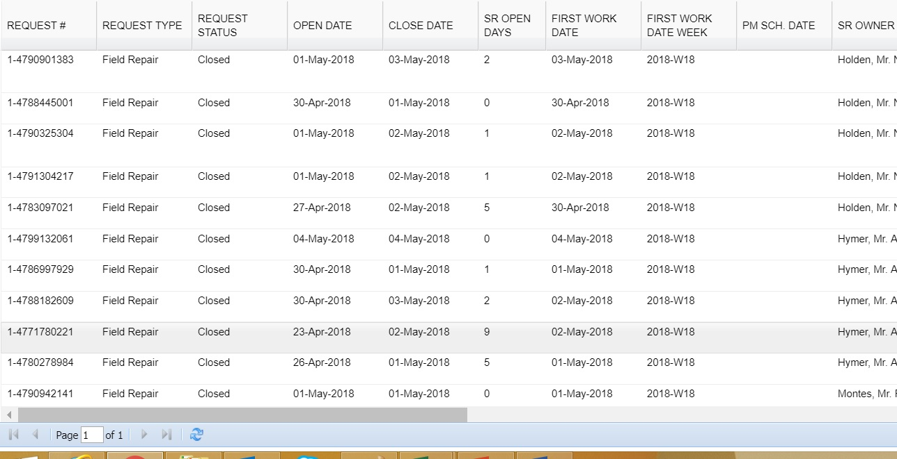
Define Phase Productivity & quality
Notes:
Measuring quality is essential but even more so because what and how measurements are taken must be relevant, accurate, and timely. It does not do an analyst any good if data is too old to be relevant or if the measurements taken were inaccurate.
A system measuring and consolidating metrics is a great tool and essential for quality.
See the list of KPIs? The only metric not meeting its goal is our Mean Time to Repair. We are currently at 2.09 and need to find what the issue is. Clicking on the metric brings up the SR data and the SR Open Days immediately tells us that we have a number SRs over our 1.5 day mark. These would need to be addressed with our technician and the root cause solved to get our technicians back on track.

Slide 8
Define Phase Problem statement
Reduce downtime of faulty equipment
Prevent repeat visits for the same problem
Improve technician’s knowledge of ongoing problem before getting to the customer
Build upon the existing ProConnect Remote Monitoring System
Automatically provide a detailed description of equipment malfunction
Automatically request necessary parts for repair
Provide a mobile application for technicians in the field
Notes:
One of the biggest problems STERIS customers face is the amount of time it currently takes to get a piece of machinery up and running once it goes down. As the largest supplier of sterilization products, it is important that customer service remain the best in the industry. One way to cut down on cost to the customer and the company is to reduce repeat visits for the same problem. This occurs when the technician does not have all the necessary parts to complete the job. So, improving the information that the technician receives will improve on the quality of services rendered.
Improvements to the ProConnect program is crucial to shorten the amount of downtime of machinery. One of the ways to improve on the program would be to add a feature which automatically request the parts required for repairs to the warehouse. Doing so will ensure that the technician does not need to return again for the same malfunction.
Lastly, the company needs to create a mobile app for our technicians to have that provides real time information on an incoming service request which gives a detailed report of the malfunction and to let him know if he needs to pick parts up at the warehouse.

Slide 9
Define Phase Critical-to-quality characteristics
Reduced downtime of equipment when malfunction occurs
Ensure equipment is performing within operational requirements
To promptly receive services from STERIS when a malfunction occurs
Minimal oversight by the customer of STERIS equipment
Notes:
As the leading supplier of sterilization products, customers demand the best from STERIS and rightfully so. Steris’ customers work in fields where sterile products are essential to their success. From hospitals to research laboratories, clean and sterile equipment is a top priority and STERIS is here to provide those reliable products and services they require to achieve their mission. As the supplier of these products, the customer should not have to worry about their machines performing their work correctly and efficiently, especially when it comes to the sterilization capabilities of the equipment because there is no room for error. As such, the customer also expects their machine running when they need it, and if the equipment were to fail, they should rest easy knowing STERIL will fix the problem quickly. Our customers have more important things to worry about than their equipment. The STERIL name is synonymous with the words “completely reliable”.

Slide 10
Measure Phase Metrics
The amount of Service Request closed on the first visit
Mean time to perform a repair
Average Number of days a SR remains open due to parts not in inventory or other circumstances
Notes:
There are three key metrics that will be in use to measure the success of the new approach:
The amount of Service Request closed on the first visit- Measuring the past times a technician was able to close a service request (SR) on the first visit before and after implementing the new method.
Mean time to perform a repair- Measuring the amount of time it took a technician to repair a specific problem before and after implementing the new strategy. The company hopes to reduce the time spent by keeping technicians informed on real time faults on their SR.
Average Number of days a SR remains open due to parts not in inventory or other circumstances- STERIS hopes that the new automatic parts request will shorten the time a SR remains open due to the lack of parts. Once the machine detects a fault, a diagnostic is sent to the service center, and simultaneously check the warehouse inventory for availability.

Slide 11
Measure Phase Key internal processes
Key Internal Processes – internal processes that influence our CTQs (Critical-to-Quality Characteristics)
Internal Processes that affect our Mean Time to Repair are:
Our Warehouse processes: part picking and shipping directly affect the speed that techs receive parts
Utilizing FedEx twice a day. 10am pickup and 7pm pickup for overnight shipping
Shipments to far places from Ohio warehouse. i.e., Hawaii, California, Washington State, Oregon.
Planning and Procuring departments not properly planning for new products due to lack of data to predict trends and needs.
Notes:
- Key internal processes are internal processes that influence our CTQs (Critical-to-Quality Characteristics)
We have a number of internal process that greatly affect our Mean Time to Repair that do not even involve our technicians.
Our sole warehouse is in Ohio, runs off EST, and utilizes FedEx twice a day, which has shown great success, but the times of pickup greatly affect the west coast state teams.
Techs cannot receive parts overnight if order is placed after 3:45pm, and that is perceived as early to our customers. If a tech is working at an account and they are paying the overtime rate, it can be two full workdays before a needed part is received due to the order being placed after 3:45pm.
Planning and Procuring could be stocking the incorrect parts if there is not historical data to have our planning based upon (Jacobs & Chase, 2014).

Slide 12
Measure Phase Current defects
Unreasonable overnight shipping and receiving limitations for the West Coast and Hawaii
Greatly hinders the customer experience and speed of which a tech can improve the equipment’s state.
Asking our West Coast customers to accommodate unreasonable limitations
Repairs can take twice as long due to shipping limitations.
Notes:
We are asking our west coast and further west customers to be okay that we refuse to address our EST limitations. We need to enhance the customer experience by increasing the time that FedEx picks up our evening shipments. Even if the delivery of the part may be at noon or later, it’s still perceived as a 1-day fix by the metric and also the customer.

Slide 13
QUESTIONS?

Slide 14
References
Jacobs, F. R., & Chase, R. B. (2014). Operations and supply chain management (14th ed.). Retrieved from The University of Phoenix eBook Collection Database.

