Slide 1

Marianne M. Jennings
Business
Its Legal, Ethical, and
Global Environment
11th Ed.
Chapter 4
Managing Disputes: ADR and Litigation Strategies

Slide 2
Types of ADR
Arbitration − Oldest Form of ADR
  Parties submit grievances and evidence to a third party expert in an informal setting
  American Arbitration Association provides many arbitrators and rules

Slide 3
Types of ADR
Arbitration Advantages
  Less formality
  Handled privately
  Expert handles the cases
  Speed was once an advantage, but tends to move as slowly as court cases now

Slide 4
Types of ADR
Arbitration Disadvantages
  Arbitrator may not have legal training and may not understand the significance of legal points
  Rules of evidence do not apply
  Expense and complexity has increased
  Cost has increased

Slide 5
Federal Arbitration Act
Passed to stop judicial interference with arbitration
Courts now rarely interfere with arbitration clauses in consumer contracts

Slide 6
Federal Arbitration Act
Courts now rarely interfere with arbitration decisions
CFPB has proposed eliminating arbitration requirement for consumer credit contract

Slide 7
Types of ADR
Case 4.1 College Park Pentecostal Holiness Church v. General Steel Corp. (2012)
  What was the basis for setting aside the arbitration clause?
  How binding is arbitration?
  Could the decision have been affected by the fact that there was a church involved?

Slide 8
Types of ADR
Arbitration Procedures
  Parties agree to submit to arbitration
  American Arbitration Association (AAA) can handle the proceedings for a fee
  Demand for arbitration is filed
  Arbitrator is selected

Slide 9
Types of ADR
Mediation
  Parties use a go-between to negotiate and communicate
    Used in international transactions
    Mediator can offer suggestions for resolution
    Not binding
MedArb
  Recent creation in which arbitrator first attempt to mediate settlement
  If unsuccessfully the case goes to arbitration

Slide 10
Types of ADR
Minitrial
  Small-scale trial where parties present case to a judge with experience in the field or to a neutral advisor
    Advisor or judge makes decision
    Can motivate parties to resolve differences even if the results are not binding

Slide 11
Types of ADR
Rent-a-Judge
  Trial held in commercial as opposed to a public court
    Pay fees for courtroom and judge
    Example: “The People’s Court” TV show
Summary Jury Trials
  Gives parties an idea about jury’s perceptions
  Used after discovery is complete

Slide 12
Types of ADR
Early Neutral Evaluation
  Consultant or volunteer gives parties an assessment of the position
    Generally used prior to discovery
    Saves expenses if parties settle following the evaluation
Peer Review
  Review of Management’s action against employee by a group of peer – employees
  Reduces litigation cost

Slide 13
International ADR
International Chamber of Commerce
  A private organization that handles 250 arbitration cases each year
  Has used arbitration since 1922

Slide 14
International ADR
Centre for Settlement of Investment Disputes (ICSID)
  An international arbitral for investors
  Investment contracts can provide for arbitration by ICSID
Parties Free to Choose Which Courts Will Hear Their Disputes
  Party autonomy
  U.S. courts are a popular choice

Slide 15
Litigation vs. ADR
Technical discovery rules | Open lines of communication
Judicial constraints of precedent | Parties can agree to virtually anything
Remedies limited | Creative remedies
Docket backlog | Parties set time line
Public proceeding | Private
Control by lawyers | Control by parties

Slide 16
Litigation vs. ADR
Expensive | Less expensive (some changes here)
Strict procedures and timing | Flexible
Judge and juries unknown | Parties select
Judicial enforcement | Enforcement by good faith

Slide 17
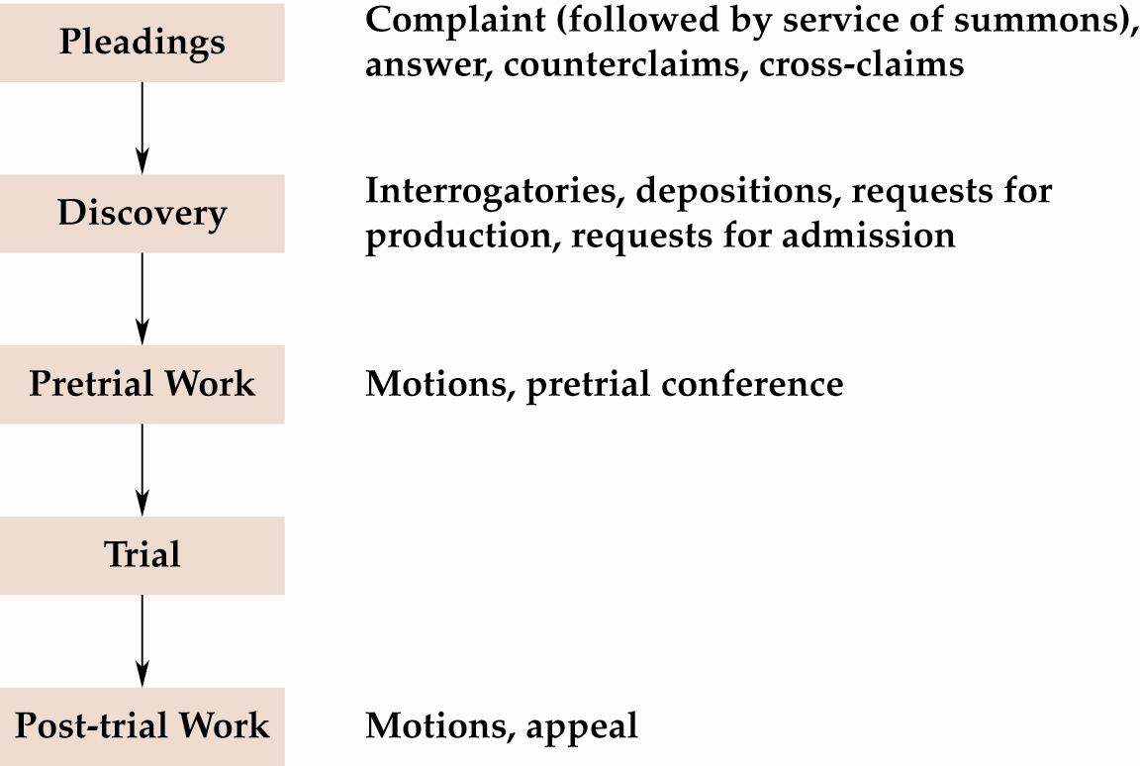
The Trial Process

Slide 18
When You Are in Litigation…
People Begin Civil Lawsuits
  System does not do it for them
    Based on a claim of right
    Lawsuits are efforts of individuals to enforce their rights

Slide 19
When You Are in Litigation…
Step 1 − Filing a Complaint or Petition
  Complaint is general statement of claim
    Must describe actions that led to claim of violation
    Must establish jurisdiction and venue of court in which it is filed
    Class actions are often filed against businesses

Slide 20
When You Are in Litigation…
Step 2 − Service of Process
  Complaint or petition and summons served on defendant
  Summons explains to defendant his/her rights
    Where to defend
    How long to defend
    The effect of not defending the suit
  Delivered by an officer of the court or by licensed private process servers
    In exceptional circumstances, service is accomplished by publication

Slide 21
When You Are in Litigation…
Step 3 − The Answer
  Content of answer
    Defendant can admit allegations in complaint are true
    Defendant can deny allegations in complaint
    Defendant can counterclaim − effect is the defendant is also suing plaintiff for damages

Slide 22
When You Are in Litigation…
Step 3 − The Answer
  Failure to file an answer within the statutory time period is a default
    Time limits for filing answers are typically twenty to thirty days
    Like a forfeit in sports − plaintiff wins because the defendant fails to show up

Slide 23
When You Are in Litigation…
Step 4 − Ending a Suit Through Motions
  Motion for judgment on the pleadings
    Even if everything the plaintiff said in the complaint were true, there is no cause for action
    If court grants motion, the case is over at the trial court level (appeal is possible)

Slide 24
When You Are in Litigation…
Step 5 − Pre Trial Motions
  Motion for summary judgment
    Appropriate in cases where there are no factual issues
    Used to resolve questions of law when the parties agree on the facts

Slide 25
When You Are in Litigation…
Step 6 − Discovery
  Forms of discovery to supplement evidence released
    Requests for admissions − request from one party to another for the admission of facts so that proof requested at trial is limited
    Interrogatories − written questions submitted to opposition
    Depositions − statements of parties or witnesses taken under oath in an informal setting
    Request for mental or physical examination or for inspection

Slide 26
When You Are in Litigation…
Step 6 − Discovery
  Requests for production: documents, physical evidence
  Only relevant, non-privileged information is discoverable
  No:
    Work product
    Attorney/client privilege
    Husband/wife privilege

Slide 27
When You Are in Litigation…
Case 4.2 Pulte Home Corp. v. Simerly (2013)
  Discuss what evidence was at issue.
  Explain what happened with the evidence and who did it.
  What should managers learn from this case and what should they do when lawyers are obtaining documents.

Slide 28
When You Are in Litigation…
Step 7 − The Trial
  Jury trial
    Required in cases where damages over $20 are claimed (unless waived)
    Absolute right to jury trial is only in criminal cases
    Jurors selected from voting or drivers’ license lists
  Voir dire
    Used to narrow jurors for panel
    Ask questions about their knowledge of the case, level of education, background, etc.

Slide 29
When You Are in Litigation…
Step 7 − The Trial
  Voir dire
    Can be challenged for cause − incapable of making an impartial decision when they know parties, when they were involved with the case
    Peremptory challenge − limited number of challenges used by attorneys to remove potential jurors with whom they are uncomfortable
    However, may not be based on race or sex

Slide 30
When You Are in Litigation…
Step 7 − The Trial
  Plaintiff’s case
    Presents witnesses − direct examination
    Defendant can cross-examine plaintiffs’ witnesses
  Opening Statement
    Gives summary of the case and witnesses and how they fit together to prove necessary elements

Slide 31
When You Are in Litigation…
Step 7 − The Trial
  Post-plaintiff’s case motion − motion for a directed verdict
    Plaintiff must prove all elements − called a prima facie case
    Failure to prove all elements entitles defendant to a directed verdict
    Made with jury excused

Slide 32
When You Are in Litigation…
Step 7 − The Trial
  Defendant’s case
    Presents witnesses − direct examination
    Plaintiff can cross-examine defendant’s witnesses
  Types of evidence
    Witnesses’ testimony
    Documents
    Photographs
    Tangible items
    Hearsay − can be admissible to establish facts other than the truth of the matter asserted

Slide 33
When You Are in Litigation…
Step 7 − The Trial
  Closing arguments
    Each side summarizes case presented
  Jury instructions
    Judge explains law to jurors
    Law is written in form for jurors to apply
    Lawyers have input on instructions

Slide 34
When You Are in Litigation…
Step 7 − The Trial
  Jury deliberations
    Some states do not require unanimous verdicts in civil cases - only a majority
    If the jury can’t reach a verdict, a hung jury results in a mistrial

Slide 35
When You Are in Litigation…
Step 7 − The Trial
  Jury verdict
    Decisions of the jury
    One side can request to have the jury polled − occasionally any pressure exerted will come out then
  Post-trial motions
    Motion for a judgment NOV (non obstante veredicto) − motion for a judgment
    Notwithstanding the verdict; effect is a trial court judge reversing the jury verdict − rarely done
    Motion for a new trial − judge orders case retried

Slide 36
Steps in Civil Litigation

Slide 37
Steps in Civil Litigation (cont’d)

Slide 38
International Litigation
Which Laws Apply?
  Foreign citizens may not come to U.S. to benefit from our traditionally liberal recovery rules and higher verdicts if there are adequate remedies in their own country

