Slide 1
Company Overview
The Nail Bar is a luxury salon that offers several services, all while serving you your favorite cocktail of choice.
The services in the Nail Bar will include spa manicures and pedicures, waxing, massage, facials, and makeup application service on weekends.
Our main goal is to make each customer enjoy the
time with the best service with a comfortable and
a relaxing environment.
Notes:
Paige

Slide 2
Company Mission/Vision
Our mission at “The Nail Bar” is to deliver a level of luxurious, pampering services. Our team of professionals offer the best service, all while serving you your favorite cocktail of choice. Luxury Nail Bar is offering premier nail care and spa treatment services to satisfy your needs and make you feel special.
Notes:
Paige

Slide 3
The Problem
Elevating how salons are run. Many salons close early in the day, not allowing those who work late hours to get to a salon in time. Salons allow young children to come in, and many run around making a non peaceful environment.
Notes:
Wafa

Slide 4
The Solution
A luxurious salon for adults who need to escape reality at later hours to fit into their busy schedules. This is a full service salon including a full bar to enjoy their favorite drink during their visit.
Notes:
Wafa

Slide 5
The Product
The ‘product’ we are providing is the luxury experience and services offered at our salon.
Services provided:
Nail Services
Waxing Services
Massage and Facial Services
CoolSculpt
Laser Hair Removal
Lash Application
Makeup Application
Full Bar Served; Cocktails, Wine, Beer
Notes:
Meg

Slide 6
The Customer
Our main target customers are busy and working people with a high income.
Customer types:
Upper-middle and upper class
Those who work long hours and need a later night service
Hard workers who need pampering
Stay at home moms
Celebrities and influencers
People over the age of 21 only
People interested in luxury services
Notes:
Meg

Slide 7
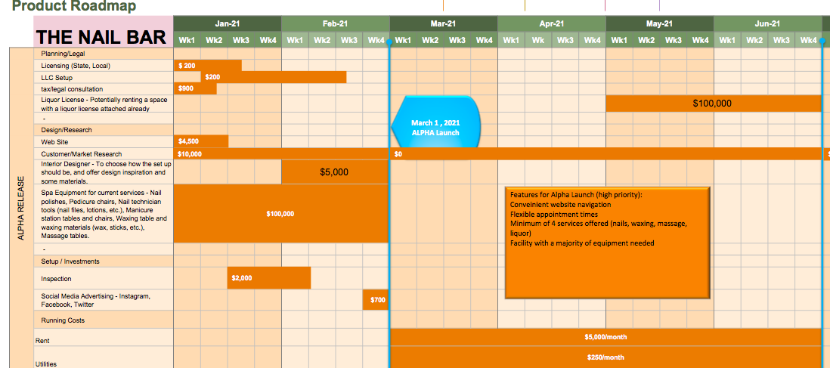
Product Roadmap
Notes:
Meg

Slide 9
The Business Model
Customers will pay per service, per visit, but will also have the opportunity to sign up for a Membership.
These Memberships will vary between what services the customer uses often. Ex.- A woman who gets her eyelashes done every two weeks will have the option to sign up for a membership to pay upfront for the entire month, 6 months, or year.
Utilizing a membership will come with perks such as discounts, freebies, and the chance for a free service when they have reached a certain point.
We are offering a pay per service and visit price as well because some customers may travel far to come once with their friends/family, and only want to pay for that day. (Ex.- Bridal parties, bachelorette parties, birthdays and other special events)
Notes:
Paige

Slide 10
Customer Acquisition Plan
-Full Service salon including massages, mani, pedi, facials, eye lashes, etc
-Full Service Bar
-Hosting private events (bridal parties, girls night out, etc.)
ers
10,000
-Word of Mouth
-Rewards System
-Membership
1,000
# Customers
100
-First location launched
-Social Media Interaction
10
1 Month
3 Months
6 Months
12 Months
24 Months
Notes:
Paige

