Slide 1
Chapter 8
Professor: Lynda Marshall, PhD

Slide 2
Chapter overview
The principles and steps in forecasting are described. The various types of forecasting methods are presented and discussed.
Qualitative and quantitative methods are compared. Choosing the appropriate method based on the demand pattern is discussed.
Methods for determining the accuracy of the forecasts are presented.

Slide 3
objectives
Identify
Identify principles of forecasting.
Explain
Explain the steps involved in the forecasting process.
Identify
Identify types of forecasting methods and their characteristics.
Describe
Describe time series models.
Describe
Describe causal modeling using linear regression.
Compute
Compute forecast accuracy.
Explain
Explain the factors that should be considered when selecting a forecasting model.
Explain
Explain the nine-step process of CPFR.

Slide 4
Forecasting introduction
Forecasts are needed as inputs to other operations decisions such as inventory planning, production scheduling, and staff scheduling and hiring.
Example: Sub Shop
Demand for the amount of food
Scheduling employees
Determining schedule for supplies, trash pick up

Slide 5
Forecasting steps
The first step is to decide what to forecast in terms of the data to forecast and the level of detail required.
1
The second step is to evaluate and analyze the appropriate data. In this step, we identify the data needed and its availability.
2
The third step is to select and test the forecasting model. We must consider different factors when selecting the model such as ease of use, cost, and accuracy.
3
In the fourth step, the forecasts are generated using the model.
4
During the last step, we monitor the accuracy of the forecasts since we may need to change the model if the environment has changed.
5

Slide 6
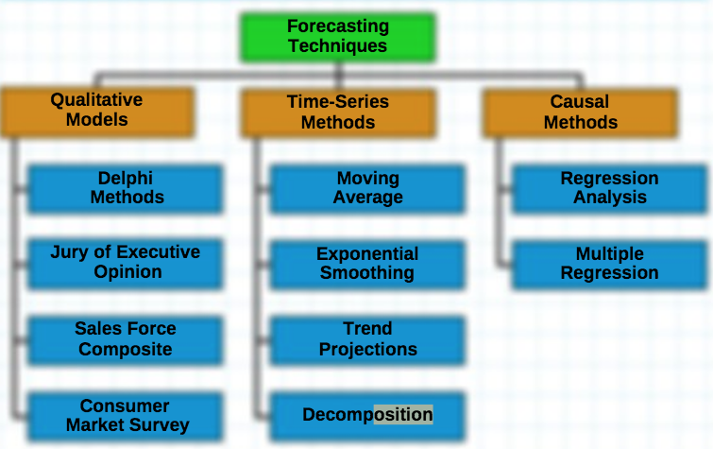
Forecasting Models

Slide 7
forecasting
Qualitative
quantitative
Qualitative methods are subjective since they rely on the educated guesses of the forecaster.
Quantitative forecasting methods are based on using calculations to make forecasts. These calculations require past data. They are more objective.
I think that qualitative methods are better because we are in a rapidly changing environment where the past is not a good predictor of the future.

Slide 8
forecasting
Qualitative
Qualitative methods are subjective since they rely on the educated guesses of the forecaster.
Quantitative
Quantitative forecasting methods are based on using calculations to make forecasts. These calculations require past data. They are more objective.
Benefits:
Gives people a general sense of where things are heading
Can lend itself to broader comparisons
some of the ups and downs of volatility are averaged out in a broader, long term view.
Benefits:
Numerical values often add strength or credibility in people’s minds regarding the forecasting.
allows for more direct comparison with historical data and prior forecasts.
Can be an aid to short term decisions

Slide 9
Types of data patterns
Level patterns show a stable demand that fluctuates around the mean.
A trend is where the data is either increasing or decreasing rather steadily over time.
Seasonality occurs when the season affects the level of demand.
Cycles are movements in the data over longer periods of time.

Slide 10
Time series and casual models
Time series models assume that the demand is only related to its own past demand patterns.
Causal models assume that the some other factors affect the variable we are trying to predict.
When thinking of level, trend, and seasonality, the same set of models can be used in most cases.
The key difference is that an additional feature or calculation is added to the model to adjust for the effect of the trend or seasonality.

Slide 11
The End
Professor: Lynda Marshall, PhD

