Slide 1
Chapter 8
Portfolio Selection—Markowitz Model

Slide 2
Markowitz Portfolio Selection
In his 1952 seminal article, Harry Markowitz stated that the objective of portfolio selection is to determine the allocation of securities in a portfolio such that it yields the maximum expected return given a specified risk or, alternatively, the minimum portfolio risk given a specified portfolio expected return.

Slide 3
Markowitz Portfolio Selection
Examine:
  The importance of correlation in determining the different return-risk combinations attainable by varying the security allocations of a two-stock portfolio
  Markowitz portfolio selection and efficiency frontier in terms of that process
  Extend the selection process to the single-index and multi-index models

Slide 4
Two-Security Portfolio
Return-Risk Relation

Slide 5
Two-Security Portfolio Return and Risk
Consider a portfolio formed from two perfectly positively correlated stocks A and B with the following expected returns and variances:
The return-risk relation of portfolios formed with these two stocks can be seen by varying the allocations of investment funds between the two stocks.
Stock A | Stock B
E(r_{A}) = 12% V(r_{A}) = 16% σ(r_{A}) = 4% | E(r_{B}) = 18% V(r_{B}) = 36% σ (r_{B}) = 6%
Correlation: | Cov(r_{A} r_{B}) = 24 ρ_{AB} = +1

Slide 6
Two-Security Portfolio Return and Risk
If all investment funds are placed in A (w_{A} = 1, w_{B} = 0), the portfolio return and standard deviation would be equal to A’s expected return and standard deviation of 12% and 4%, respectively.
If half of the funds are invested in A and half in B, then the portfolio expected return would be 15% and the portfolio standard deviation would be 5%:
If all funds are place in B, then the portfolio return and risk would equal stock B's expected return and standard deviation of 18% and 6%, respectively.

Slide 7
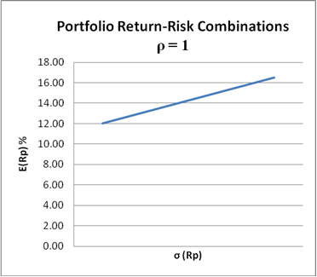
Two-Security Portfolio Return and Risk
Portfolio | w_{A} | w_{B} | E(R_{p}) | σ (R_{p})
1 | 1 | 0 | E(R_{A}) = 12% | (R_{A}) = 4
2 | 0.75 | 0.25 | 13.5% | 4.5
3 | 0.5 | 0.5 | 15.0% | 5.0
4 | 0.25 | 0.75 | 16.5% | 5.5
5 | 0 | 1 | E(R_{B}) = 18 | σ (R_{B}) = 6
Return-risk combinations obtained from a portfolio of stock A and stock B that have perfect positive correlation:
E(r_{A}) = 12%
σ(r_{A}) = 4
E(r_{B}) = 18%
σ(r_{B}) = 6
ρ_{AB} = 1
The figure shows a positive linear relationship between portfolio return and risk

Slide 8
Two-Security Portfolio Return and Risk
The linear relationship suggests that the portfolio’s return and risk are simply linear combinations of the return and risk of the two securities and do not depend on the correlation between securities.
That is, when the correlation coefficient is one, the portfolio variance (or standard deviation) depends only on the securities’ variances (or standard deviations). That is:

Slide 9
Two-Security Portfolio Return and Risk
Intuitively, if two securities move in perfect unison with each other, there is no correlation benefit, and therefore the different portfolio return and risk combinations are linear combinations of the two securities’ returns and risks.

Slide 10
Two-Security Portfolio Return and Risk
Consider the portfolio return-risk relation if the returns of stocks A and B are assumed to be perfectly negatively correlated.
In this case, the portfolio return-risk relationship is characterized by two linear segments: A negatively sloped segment and a positively sloped segment.
  The negatively sloped segment extends from the 12% and 4% return-risk combination obtained by placing all funds in the low return-risk stock A to the 14.4% return and zero risk combination on the vertical axis obtained by investing 60% in A and 40% in B.
  The positively sloped segment extends from the vertical intercept to the 18% and 6% return-risk combination obtained by investing all funds in the high return-risk stock B.

Slide 11
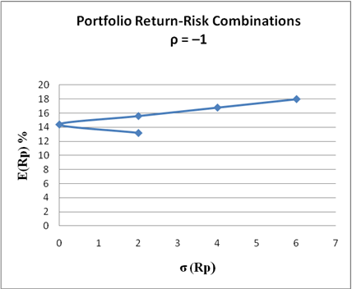
Two-Security Portfolio Return and Risk
Portfolio | w_{A} | w_{B} | E(R_{p}) | (R_{p})
1 | 1 | 0 | E(R_{A}) = 12% | σ (R_{A}) = 4
2 | 0.8 | 0.2 | 13.2% | 2
3 | 0.6 | 0.4 | 14.4% | 0
4 | 0.4 | 0.6 | 15.6% | 2
5 | 0.2 | 0.8 | 16.8% | 4
6 | 0 | 1 | E(R_{B}) = 18% | σ (R_{B}) = 6
Return-risk combinations obtained from a portfolio of stock A and stock B that have perfect negative correlation:
E(r_{A}) = 12%
σ(r_{A}) = 4
E(r_{B}) = 18%
σ(r_{B}) = 6
ρ_{AB} = −1
The positive-sloped portion of the figure includes all efficient portfolios
The negatively-sloped portion consists of inefficient portfolios.
The vertical intercept represents a zero risk portfolio.
Whenever securities are perfectly negatively correlated, a graph of the portfolio's return-risk relation will always touch the vertical axis

Slide 12
Two-Security Portfolio Return and Risk
The positive-sloped portion of the figure includes all efficient portfolios and the negatively-sloped portion consists of inefficient portfolios.
Efficient portfolios are defined as those that yield the maximum return for a given risk, whereas inefficient portfolios are those that yield the minimum return for a given risk.
Thus, at the 12%, 4% coordinate the return of 12% is the lowest return an investor can obtain for assuming a risk of 4. By changing the allocation from w_{A} = 1 and w_{B} = 0, to w_{A} = 0.20 and w_{B} = 0.80, the investor can move up to the positively sloped segment where for a risk of 4% the maximum return of 16.8% is obtained.
Finally, note that the vertical intercept represents a zero risk portfolio. Whenever securities are perfectly negatively correlated, a graph of the portfolio's return-risk relation will always touch the vertical axis

Slide 13
Two-Security Portfolio Return and Risk
Return-risk relation for various correlation coefficients
In the exhibit, the return-risk relationships for both correlation cases are plotted on the same graph.
The two curves define the limits within which all portfolios of these two securities must lie for any intermediate correlation coefficient between ρ_{AB} = –1 and ρ_{AB} = +1.
To fit into the triangle abc, the curve depicting the return-risk relation for intermediate correlation has to be convex.

Slide 14
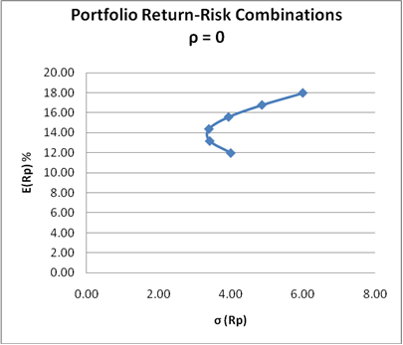
Two-Security Portfolio Return and Risk
Portfolio | w_{A} | w_{B} | E(R_{p}) | σ (R_{p})
1 | 1 | 0 | E(R_{A)} = 12% | (R_{A}) = 4
2 | 0.8 | 0.2 | 13.2% | 3.42
3 | 0.6 | 0.4 | 14.4% | 3.39
4 | 0.4 | 0.6 | 15.6% | 3.93
5 | 0.2 | 0.8 | 16.8% | 4.68
6 | 0 | 1 | E(R_{B}) = 18% | σ (R_{B}) = 6
Return-risk combinations obtained from a portfolio of stock A and stock B that have zero correlation:
E(r_{A}) = 12%
σ(r_{A}) = 4
E(r_{B}) = 18%
σ(r_{B}) = 6
ρ_{AB} = 0

Slide 15
Convexity
Convexity
The convex return-risk relation implies that as you move up from the middle of the return-risk graph, you become more specialized in the high return-risk stock.
As a result, the portfolio risk takes on progressively more and more of the risk of the high-risk security.
In addition, as the portfolio becomes more specialized (and therefore less diversified) it loses the covariance effect.
Combined, the increasing proportion allocated to the risky security and the loss of the covariance effect due to specialization causes the portfolio risk to increase at an increasing rate as you move up the efficiency frontier.
Since the correlations among many securities are less than one, many portfolio return-risk relations are characterized by this convex relation.

Slide 16
Correlation and Return-Risk Relation
Note: The further from +1 the correlation coefficient is, the more dominant the portfolio’s return-risk combinations.
Thus, for a given risk over the positively sloped portion of the curves portfolio, the returns are greater for correlation coefficients farther from +1.

Slide 17
Correlation and Return-Risk Relation
Note: The return-risk curves with intermediate correlations has a vertical point (inflection point) where the slope of the curve is zero.
This point represents the minimum variance portfolio (MVP).
For a two-security portfolio, this portfolio can be found with calculus by taking the derivative of the portfolio variance equation with respect to one of the weights, setting the derivative equal to zero, and solving the resulting equation for the weight. Doing this, one obtains:

Slide 18
Unique Return-Risk Combinations for Two-Security Portfolios
For a two-security portfolio each return-risk combination is unique; that is, each return-risk combination is associated with one allocation.
For portfolios with more than two securities, there are a number of allocations that can yield the same portfolio return and a number of allocations that can yield the same portfolio risk.
When the number of securities in a portfolio exceeds two, then the portfolio selection problem is one of determining the allocation that will yield an efficient portfolio—Markowitz portfolio selection.

Slide 19
Markowitz Portfolio Selection
Math Approach

Slide 20
Portfolio Selection: Math Approach
There are several approaches that can be used to solve for the security allocations that satisfy the Markowitz portfolio selection objective.
One of these is the mathematical approach.
The math approach uses differential calculus to find the allocation that will minimize the portfolio variance subject to the constraints that the weights sum to one and a specified portfolio return is attained, or the allocation that will maximize the portfolio return subject to the constraints that the weights sum to one and a specified portfolio variance is attained.

Slide 21
Portfolio Selection: Math Approach
For a three-stock portfolio, the objective of portfolio variance minimization would be to solve for the w₁, w₂, and w₃ allocation that would yield the minimum portfolio variance (Min V_{p}), subject to the constraints that w₁, w₂, and w₃ sum to one and yield a specified portfolio return, E_{p}*:
Portfolio Inputs:
Objective Function:
First constraint:
Second constraint:

Slide 22
Portfolio Selection: Math Approach
The math approach for portfolio maximization given a specified portfolio variance is similar to the variance minimization approach.
In this case, the objective function is the portfolio expected return and the constraint is the portfolio variance.
The portfolio return maximization approach is consistent with the portfolio variance minimization approach, yielding the same allocation as the portfolio variance approach.

Slide 23
Portfolio Selection: Math Approach
This constrained optimization problem can be solved mathematically using the Lagrangian technique. The approach is presented in Appendix 8A (text website) along with an example.
The math approach for solving for Markowitz efficient portfolios is capable of handling large portfolios.
Its limitation is that the solutions do not necessarily exclude negative weights.
Thus, it is possible to obtain an optimum portfolio that requires taking a short position in a poor security and using the proceeds to invest in other securities in the portfolio. Since many investors do not consider shorting poor securities, the mathematical approach may not be practical.

Slide 24
Using the Bloomberg CORR Screen and Excel to Solve for Markowitz Efficient Portfolios Using the Math Approach

Slide 25
Portfolio Selection: Using Bloomberg and Excel to Generate Efficient Portfolios—Math Approach
The CORR screen can be used to create and save a number of correlation matrices for securities, indices, currencies, interest rates, and commodities. The matrix also shows a variance-covariance matrix (Cov) for portfolios up to 10 stocks.
A portfolio created in PRTU can be imported into CORR. To import: (1) Click “Create New” tab; (2) select dates and period for statistical analysis (e.g., Date Range: 8/5/2006 to 8/8/2013 and weekly periods); (3) in Matrix Securities Box, click “Symmetric Matrix box,” and “Add from Sources” tab, Select “Portfolio,” Name of Portfolio (e.g., Blue Rock), click “Select All,” and click “Update.”
On the CORR screen, you can obtain the variance-covariance matrix by selecting “Covariance” from the dropdown “Calculations” tab.
Matrices in CORR can be exported to Excel by clicking “Export to Excel” in the dropdown “Export” tab in the far right corner of the screen.

Slide 26
Portfolio Selection: Using Bloomberg and Excel to Generate Efficient Portfolios—Math Approach
A coefficient matrix, A, formed from a variance-covariance matrix and its inverse, A⁻¹, can be used to solve for the Markowitz efficient portfolio; these matrices can be created in Excel. That is, given the exported variance-covariance matrix, matrix A is formed by arraying the variance-covariance matrix with a column vector of the products of stock returns times 0.5, a column vector of ones and zeros, a row vector of stock returns, and a row vector of ones and zero.
The inverse matrix, A⁻¹, is generated by highlighting the cells for the matrix entering the command: “=minverse (Array)”, and then pressing CTrl + shift + Enter.
The efficient weight vector, W, for a given portfolio return, E_{p}* is calculated by multiplying the A⁻¹ matrix by a constant vector, k, consisting of zeros, the specified portfolio return and one. In Excel, the product matrix is generated by first creating the k vector in a column and multiplying matrix A⁻¹ by k; this is done by highlighting an Excel column, entering the command: =mmult (Array 1, Array2)”, and then pressing CTrl + shift + Enter.

Slide 27
Portfolio Selection: Using Bloomberg and Excel to Generate Efficient Portfolios—Math Approach
The portfolio variance associated with efficient weights is obtained by multiplying the variance-covariance matrix, V, by a column vector of efficient portfolio weights, W, and then multiplying VW by the transpose of W: Vp = W/ V W.
A number of efficient portfolios can be created by simply changing the specified portfolio return, E_{p}*.

Slide 28
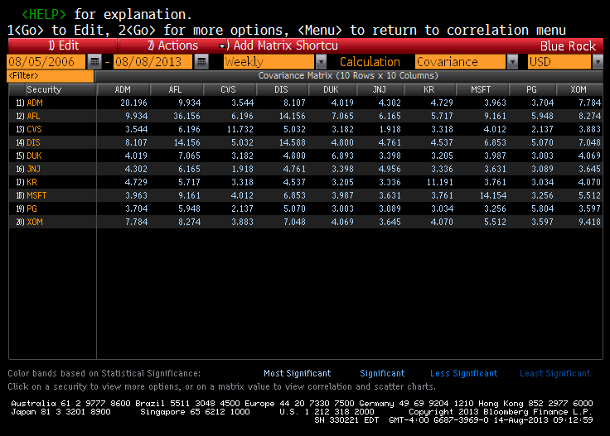
Portfolio Selection: Using Bloomberg and Excel to Generate Efficient Portfolios—Math Approach
On the CORR screen, you can obtain the variance-covariance matrix by selecting “Covariance” from the dropdown “Calculations” tab.
Matrices in CORR can be exported to Excel by clicking “Export to Excel” in the dropdown “Export” tab in the far right corner of the screen (tab not shown here).
CORR SCREEN

Slide 29
Markowitz Solution in Excel: Matrix A, A⁻¹, k, and W

Slide 30
Efficiency Portfolios: Different E_{p}
Portfolio Selection: Using Bloomberg and Excel to Generate Efficient Portfolios—Math Approach

Slide 31
Markowitz Portfolio Selection
Quadratic Programming
Excel Solver

Slide 32
Portfolio Selection: Quadratic Programming
An alternative to the mathematical approach is quadratic programming (QP).
QP is an algorithm that iteratively solves for the security weights that yield the minimum portfolio variance subject to three constraints:
  The weights sum to one
  The weights yield a specified portfolio expected return
  Each weight is nonnegative
With the non-negative weight constraints, quadratic programming provides a more practical approach to constructing portfolios that satisfy the Markowitz objective.

Slide 33
Portfolio Selection: Quadratic Programming
Quadratic programming (QP) is an algorithm that iteratively solves for the security weights that yield the minimum portfolio variance subject to three constraints: the weights sum to one, they yield a specified portfolio expected return, and each weight is nonnegative. For a three-stock portfolio, the QP approach can be defined as follows:
Portfolio Inputs:
Objective Function:
First constraint:
Second constraint:
Third constraint of non-negative weights:

Slide 34
Excel Solver Approach: Bloomberg’s Asset Allocation Optimizer Template
In Excel, efficient portfolios (maximum E_{p}* given V_{p} or minimum V_{p}* give E_{p}) with non-negative weight constraints can be generated using the Excel Solver Add-In.
Such programs yield results similar to QP-generated portfolios.
A Bloomberg Excel program that uses Excel Solver for solving for such portfolios, “Asset Allocation Optimizer,” can be downloaded from the Bloomberg Excel Template library found on the DAPI screen (DAPI <Enter>; click Portfolio topic, and “Asset Allocation Optimizer.”)

Slide 35
Excel Solver Approach: Bloomberg’s Asset Allocation Optimizer Template
To use the program:
Input the stock tickers (for stocks, ticker with the “Equity” moniker, for indexes, ticker with “Index” moniker, etc.).
Input average returns or expected returns.
Select the time period for calculating the variance-covariance matrix.
Select minimum weight and maximum weight constraints for each stock; here the user can set the minimum weights to zero and the maximum weight at 99% (or another specified constraints).
Input the risk-free rate and values for the optimization programs: the portfolio standard deviation for portfolio maximization optimization and portfolio return for portfolio variance minimization.
Click “Optimize Weights” tab to run the program.

Slide 36
Asset Allocation Optimizer Template
Input the stock tickers (for stocks, ticker with the “Equity” moniker, for indexes, ticker with “Index” moniker, etc.).
Input average returns or expected returns.
Select the time period for calculating the variance-covariance matrix.
Select minimum and maximum weight constraints for each stock; here the user can set the minimum weights to zero and the maximum weight at 99% (or another specified constraints).
Input the risk-free rate and values for the optimization programs: the portfolio standard deviation for portfolio maximization optimization and portfolio return for portfolio variance minimization.
Click “Optimize Weights” tab to run the program.

Slide 37
Asset Allocation Optimizer Template
The exhibit shows the optimum solutions for the ten stocks making up the Blue Rock Fund.
The variance-covariance matrix is calculated for the time period from 8/5/2006 to 8/8/2013 (weekly prices are used), the expected stock returns are based on averages over a more recent time period, the specified portfolio return is 15.5%, and the specified annualized portfolio standard deviation is 17%.
The optimum portfolio weights for the variance minimization are 30.7% in CVS, 21.4% in Disney, 22% in Johnsons & Johnson, and 25.9% in Kroger.
The annualized variance is equal to period variance (e.g., weekly) times the number of periods of that length (week) in a year (52). The annualized standard deviation is equal to the square root of the annualized variance .

Slide 38
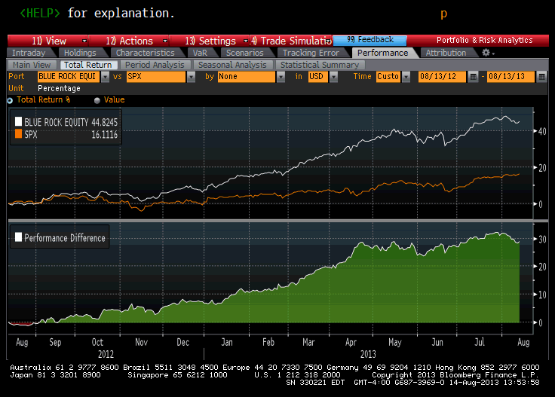
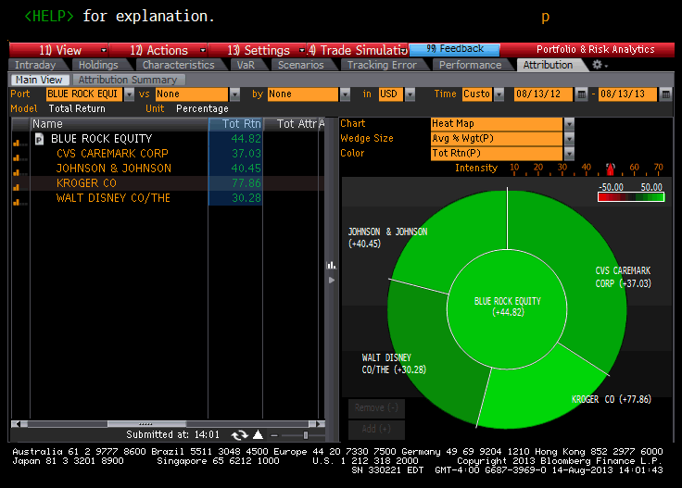
Asset Allocation Optimizer Template
The ex-post total returns for the one-year period from 8/13/12 to 8/13/13 for the Markowitz efficient portfolio and the S&P 500 are shown in the exhibit slide (Bloomberg’s PORT screen, Performance tab and Total Return tab).
The back testing results show the portfolio outperforms the market for one-year period (total return of 44.82% compared to 16.11% total return for S&P 500).

Slide 39
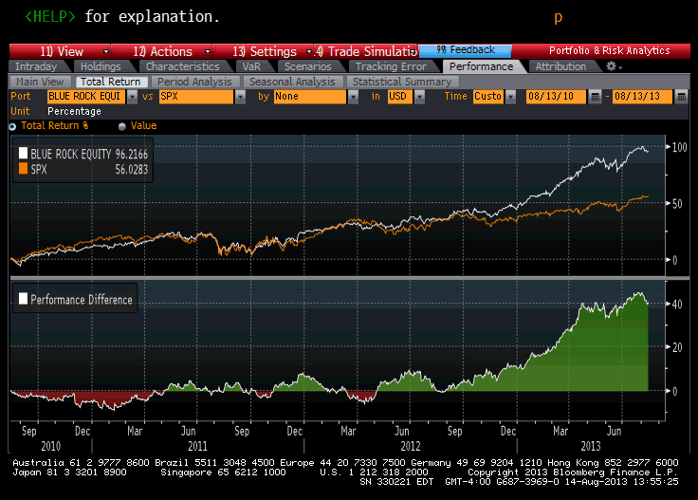
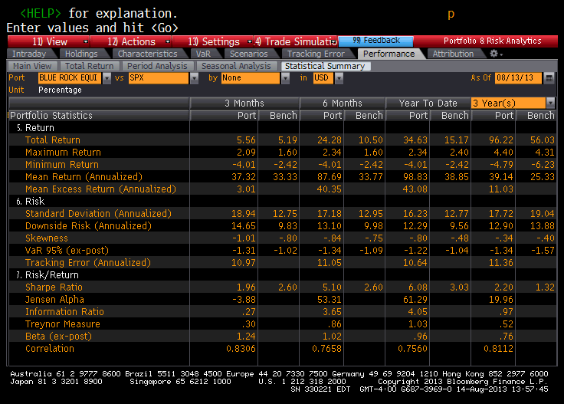
Asset Allocation Optimizer Template
The ex-post total returns for the three-year period from 8/13/10 to 8/13/13 for the Markowitz efficient portfolio and the S&P 500 are shown in the exhibit slide (Bloomberg’s PORT screen, Performance tab, and Total Return tab).
The back testing results show the portfolio outperforms the market for the three-year period (total return of 96.22% compared to 56.03% total return for S&P 500).
Using the Bloomberg PORT screen (Performance tab and Statistics Summary tab) the Markowitz portfolio has a beta close to one based on year-to-date calculation, as well as a very large alpha, suggesting abnormal returns.

Slide 40
Efficiency Frontier

Slide 41
Efficiency Frontier
The Markowitz portfolio selection objective can be restated as one of deriving an efficiency frontier, EF.
An efficiency frontier is a graph showing the portfolio expected return, E(R_{p}), and standard deviation, σ(R_{p}), combinations that are Markowitz efficient; that is, satisfy the Markowitz objective of maximum E(R_{p}) given a specified V(R_{p}), or minimum V(R_{p}) given a specified E(R_{p}).
There are three steps involved in generating an efficiency frontier.

Slide 42
Efficiency Frontier
Step 1: The first step is to estimate the portfolio inputs: E(r_{i}), V(r_{i}), and Cov(r_{i} r_{j}).
These parameters can be estimated using either historical averages or a regression a model.
There are several regression models that can be used.
  The simplest is the single-index model in which each security’s return is regressed against the market return.
  Some practitioners also use a multi-index model in which each security’s return is regressed against several explanatory variables.

Slide 43
Efficiency Frontier
Step 2: The next step is to generate Markowitz efficient portfolios.
This can be done using either the math approach, quadratic programming, or Excel Solver.
With any of these approaches, one would first specify a number of portfolio expected returns (or variances), then solve for the weights that would yield the minimum portfolio variance (or maximum portfolio return) for each return (or variance).
Each portfolio return and variance would be either a Markowitz efficient or inefficient portfolio.

Slide 44
Efficiency Frontier
Step 3: The last step is to plot each portfolio’s expected return and standard deviation (not portfolio variance) to generate the efficiency frontier.

Slide 45
Efficiency Frontier Features
The EF features similar to the return-risk graph for a two-security portfolio previously discussed:
First, like the two-security return-risk graph, EF is characterized by both a negatively sloped portion and positively sloped portion. The negatively sloped portion of EF represents the inefficient portfolios [minimum E(R_{p}), given σ(R_{p})], whereas the positively-sloped portion shows the efficient portfolios [maximum E(R_{p}), given σ(R_{p})].
Second, the efficiency frontier, like the portfolio return and risk curve for a two-security portfolio is convex from below, except for cases in which the securities are perfectly positively or negatively correlated.
  As discussed with the two-security portfolio, the convexity of the efficiency frontier is explained by the increase specialization in the high-risk security and the loss of the covariance effect that occurs as one moves up the efficiency frontier.
Finally, the efficiency frontier has a vertical segment (inflection point) that defines the minimum variance portfolio.

Slide 46
Efficiency
Frontier
The efficiency frontier and table for the portfolio generated by using the Bloomberg “Asset Allocation Optimizer”

Slide 47
Best Efficient Portfolio
All portfolios along the positively sloped portion of the efficiency frontier are Markowitz efficient; that is, all have the maximum E(R_{p}) given V(R_{p}), or minimum V(R_{p}) given E(R_{p}).
From this set of efficient portfolios, it is possible to determine the best portfolio by using the borrowing-lending line to rank portfolios (examined in Chapter 7).

Slide 48
Best Efficiency Frontier
Using the borrowing-lending line to rank, portfolio E represents the best portfolio.
This is because the borrowing and lending line constructed with portfolio E has the steepest slope (largest λ).
Thus, the return-risk combinations available with portfolio E and a risk-free security dominate the return-risk opportunities available from any other efficient portfolios and the risk-free security.
If the efficiency frontier is convex then the best portfolio, such as E, is determined at the point of tangency of the efficiency frontier and the borrowing and lending line.
Furthermore, if the efficiency frontier is convex, then the best portfolio would be defined as one of the middle points on EF (not at a corner), implying that the best portfolio would be diversified.

Slide 49
Efficiency Frontiers for Stocks with Perfect Positive Correlation
If the securities in the portfolio are perfectly positively correlated, then the efficiency frontier is linear and the best portfolio will be one that is at one of the corners.
Since the corner points of an efficiency frontier defines a one-security portfolio (either the low return-risk security or the high return-risk security), the best portfolio therefore consists of only one securities.

Slide 50
Efficiency Frontiers for Stocks with Perfect Positive Correlation
Thus, if the securities in the portfolio are perfectly positively correlated, then there is no benefit to diversification and the best portfolio consists of either the low return-risk security or the high return-risk security.
This observation confirms a previously stated observation that if securities are moving in unison, there is no diversification benefit and a portfolio with a large number of perfectly positively correlated securities would be superfluous.

Slide 51
Efficiency Frontiers for Stocks with Perfect Negative Correlation
If the securities are perfectly negatively correlated, then the best portfolio (i.e., the one with the steepest borrowing-lending line) would be the zero risk portfolio obtained with limited diversification in the two securities that are perfectly negatively correlated.

Slide 52
Efficiency Frontiers for Stocks with Perfect Negative Correlation
If the securities are in fact perfectly negatively correlated, or if two perfectly negatively correlated positions are formed (e.g. long stock position and a short stock position formed with stock option positions), then an arbitrage opportunity would exist if the risk-free rate were different than the portfolio rate associated with the zero risk portfolio.
For example, if the risk-free rate were less than the zero-risk portfolio’s rate, then an arbitrageur would borrow as much as she could to invest in the portfolio. By doing this, the arbitrageur would realize a free lunch: a future dollar return with no risk and no investment—an arbitrage.

Slide 53
Bloomberg Screens
Asset Allocation Optimizer

Slide 54
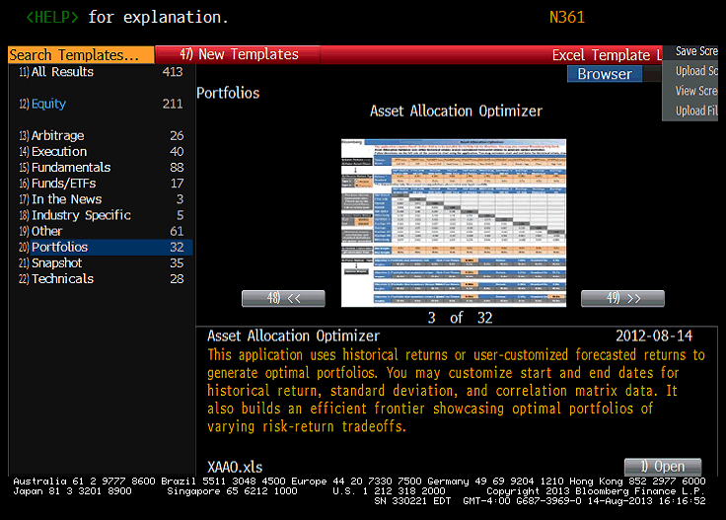
Bloomberg’s Asset Allocation Optimizer
To access Asset Allocation Optimizer Excel template go to the template library found on the DAPI screen (DAPI <Enter>) and click “Excel Template Library,” “Equity,” and “Portfolios.”

Slide 55
Bloomberg’s Asset Allocation Optimizer
As described in the Template’s “Help” sheet, the optimization program uses historical returns or user-customized forecasted returns to generate optimal portfolios.
You can customize beginning and ending dates for the historical returns, standard deviation, and correlation matrix data.
The spreadsheet uses Microsoft Excel's Solver Add-in to solve portfolio equations to find optimal portfolios.
Instructions are provided in Help for uploading the Add-in if it is not already on your Excel spreadsheet.
The program generates optimal portfolios in the “Optimizer tab” and builds an efficient frontier in the “Efficient Frontier” tab.

Slide 56
Bloomberg’s Asset Allocation Optimizer
On the Optimizer tab, you can generate optimal portfolios based on the following:
Inputs for “Optimizer tab”:
Stock tickers: for stocks, ticker with the “Equity” moniker, for indexes, ticker with “Index” moniker, etc.
Average returns or expected returns (averaged are calculated based on the time period chosen; expected stock returns are inputted)
Time period for calculating averages, standard deviations and correlation matrix
Minimum weight constrains for each inputted security (e.g., 0)
Maximum weight constraints for each stock (e.g., 99%)
Risk-free rate
Portfolio standard deviation for portfolio maximization optimization
Portfolio return for portfolio variance minimization
Optimal portfolio that minimizes risk
Optimal portfolio that maximizes return
Optimal portfolio that maximizes the Sharpe Ratio
Optimal portfolio that minimizes risk, given a user-selected minimum acceptable return
Optimal portfolio that maximizes return, given a user-selected maximum acceptable risk
Efficient Frontier Tab creates an efficient frontier showing the efficient portfolios based on the returns, standard deviations, correlations, and constraints chosen on the "Optimizer" tab.

Slide 57
Bloomberg’s Asset Allocation Optimizer

Slide 58
Single-Index Model

Slide 59
Single-Index Model
Developed by William Sharpe, the single-index model (also called the diagonal model) assumes that all securities in a portfolio are related just to the market return and that there is no correlation between the unsystematic risks of securities.
Combined, these assumptions imply that co-movements between securities in a portfolio are related to a single factor—the market return. As a result, in the single-index model one does not have to estimate the correlations between stocks in the portfolio; instead, one only has to estimate each security's relation to the common factor.

Slide 60
Single-Index Model
Formally, the single-index model assumes that each security i in the portfolio being evaluated is only related to the market as described by the regression model:
The model also assumes that the standard regression assumptions hold for each security in the portfolio and that there is no correlation between the error terms of the stocks; that is, the covariance between the errors of any two securities j and k is zero:
  Each stock's ε is normally distributed
  E(ε_{i}) = 0, for all securities
  Each stock’s V(ε) is constant over all observations
  Cov(ε_{j} ε_{k}) = 0 for all securities

Slide 61
Single-Index Model
From these assumptions the expected returns, variances, and covariances of the stocks in the portfolio are

Slide 62
Single-Index Model
Note:
Each stock's variance in the portfolio depends on its sensitivity to the market as measured by β, the variability of the market, V(R^{M}), and the stock's unsystematic risk as measured by V(ε_{i}).
The co-movement of securities is related just to the movement of the market. This result follows directly from the assumption that ε_{j} is independent of ε_{k}. This implies that there is no correlation between each security's industry and firm factors; thus, the co-movement of securities is explained only in terms of their relative movements to the market.
If we do not assume that the errors are uncorrelated, then each covariance term in the portfolio would include a cov(ε_{j} ε_{k}). A model that assumes each security in the portfolio is related only to the market but does not assume cov(ε_{j} ε_{k}) = 0 is known as the market model.

Slide 63
Single-Index Model
Equations E(r), V(r), and Cov(r_{j} r_{k}) define the expressions for the expected return, variance, and covariance used in the single-index model.
To estimate this model requires estimating an α_{i,} β_{i}, and V(ε_{i}) for each security, and estimating the expected return and variance of the market, E(R^{M}) and V(R^{M}).
These parameters can be estimated either through a regression analysis using historical data or ndependently.

Slide 64
Single-Index Model
For an n-security portfolio, the number of parameters to estimate is 3n + 2. In contrast, to estimate the portfolio inputs using historical averages would require ([n² – n]/2) + 2n estimates.
Thus, for a 100-security portfolio, the single-index model would require 302 estimates, and for a 200-security portfolio, it would require 602 estimates.
Using averages, on the other hand, would require estimating 5,150 parameters for the 100-security portfolio and 20,300 parameters for the 200-security portfolio.
Thus, the single-index model greatly simplifies the computation for generating portfolio inputs.

Slide 65
Portfolio Return and Risk in Terms of the Single-Index Model
In the single-index model, the portfolio expected return and portfolio variance can be expressed in forms similar to the security's expected return and variance:
  where: the portfolio coefficients α_{p}, β_{p}, and ε_{p} are equal to the weighted sum of the stocks’ parameters

Slide 66
Portfolio Return and Risk in Terms of the Single-Index Model
The portfolio return has the same form as the regression equation for a stock. Thus, by analogy, the portfolio expected return and variance are
    where:

Slide 67
Portfolio Return and Risk in Terms of the Single-Index Model
The E(R_{p}) and V(R_{p}) Equations define the portfolio expected return and variance in terms of the single-index model.
The equations are similar in form to the regression equations for a stock's return and variance.
In practice, analysts often regress a portfolio's rate return against the market instead of the securities that make up the portfolio.
When a portfolio's return is regressed against the market, then the intercept and slope of the regression equation (α_{p} and β_{p}) can be interpreted as being the weighted α's and β's of the securities making up the portfolio.

Slide 68
Portfolio Return and Risk in Terms of the Single-Index Model
The variance equation decomposes the portfolio's risk into its systematic and unsystematic risk components.
As with a security, the systematic risk of a portfolio is that risk that can be explained by market factors (those factors which affect all securities), whereas unsystematic risk is risk that can be explained by the industry and firm factors affecting each security that makes up the portfolio.

Slide 69
Portfolio Return and Risk in Terms of the Single-Index Model
In discussion of portfolio risk and size, we noted that unsystematic risk can be diversified away with a portfolio consisting of approximately 30 stocks.
If the portfolio under consideration is of this size or more, then V(ε _{p}) would be equal to zero.

Slide 70
Portfolio Return and Risk in Terms of the Single-Index Model
The next two exhibit slides shows the α_{i,} β_{i}, and V(ε_{i}) for the 10 stocks presented in the earlier example and their variance-covariance matrix. The parameters values were pulled from Bloomberg’s RV screen.
The Bloomberg values for alpha, beta, and the standard deviation of the error term for the 10 stocks were calculated for the 2012–2013 time period (different than the previous example).
The estimated expected returns and variances for each stock were generated using E(r) and V(r) single-index equations and by assuming an expected market return of 16%, a market variance of 20%, and risk-free rate of 5%:
The stocks are ranked in the order of each one’s Treynor index:

Slide 71
Single-Index Model

Slide 72
Single-Index
Model
Variance-Covariance Matrix

Slide 73
Portfolio Return and Risk in Terms of the Single-Index Model
For an equally allocated portfolio (w_{i} = 1/10) formed with the 10 stocks, the portfolio beta is 0.9016, the portfolio alpha is 0.0348, and the portfolio’s unsystematic risk, V(ε_{p}), is 0.41965:

Slide 74
Portfolio Return and Risk in Terms of the Single-Index Model
For an expected market return of E(R^{M}) = 16% and market variance of V(R^{M}) = 20% (σ(R^{M}) = 4.47), the portfolio expected return is 14.46%, its variance is 16.68, and its standard deviation is 4.084.

Slide 75
Bloomberg Regression, CIXB, and Correlation Screens

Slide 76
Bloomberg Regression Screens
HRA and Beta: Bloomberg’s Linear Regression Screen
The Bloomberg HRA and Beta screens show the linear regression of a loaded security and an index or other security.
See Chapter 6 PPT and Bloomberg exhibit box in Chapter 6: “Bloomberg Regression and Correlation Screens.

Slide 77
Bloomberg CIXB Screen
CIXB
The returns of a portfolio in EQS or PRTU can be evaluated using historical regression by putting the portfolio into a CIXB basket, creating historical data, and then treating the portfolio as an index.

Slide 78
Bloomberg CIXB Screen
Steps:
CIXB <Enter>
On the CIXB screen, name the ticker and the portfolio in the “.Ticker” and “Name” yellow boxes and hit <Enter> to update (.XSIF13 for ticker and XSIF 2013 for Name).
Click “Import” from the Actions dropdown tab.
On the “Import to CIXB” box, click “import from list” tab at bottom to bring up “import from list” box.
On “Import from List” box: Select Portfolio (or EQS search or index) from the “Source” dropdown and the name of the portfolio (EQS search or index) from the “Name” dropdown, and then click the “Import” tab. These steps will import the portfolio’s stocks, shares, and prices to the CIXB screen.
On CIXB screen, click the “Create” tab to bring up a time period box for selecting the time period for price and return data. After selected the time period, hit “Save.” This will activate a Bloomberg program for calculating the portfolio’s daily historical returns.
The data will be sent to a report, RPT. To access this report, type “RPT” and hit <Enter>.

Slide 79
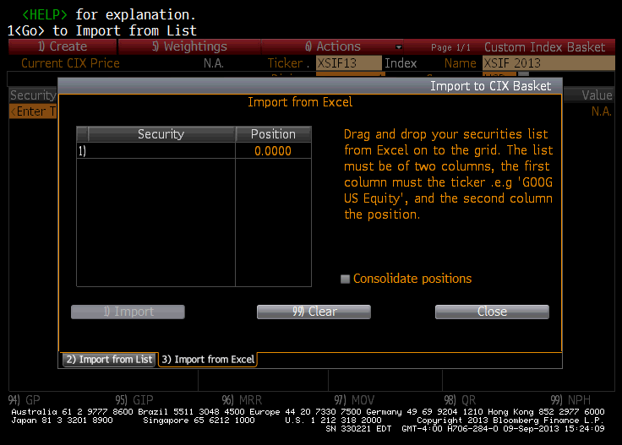
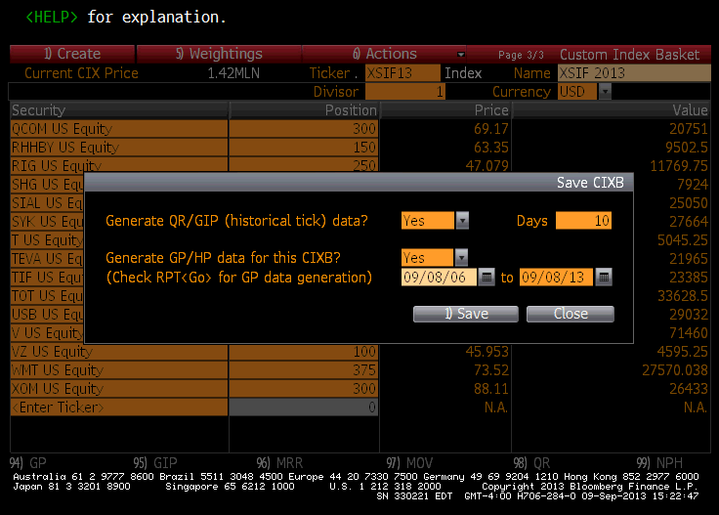
CIXB
On the CIXB screen, name the ticker and the portfolio in the “.Ticker” and “Name” amber boxes and hit <Enter> to update (.XSIF13 for ticker and XSIF 2013 for Name. Click “Import” from the Actions dropdown tab to bring up “Import to CIXB” box.
On the “Import to CIXB” box, click “import from list” tab at bottom to bring up “import from list” box.
On “Import from List” box: Select Portfolio from the “Source” dropdown and the name of the portfolio from the “Name” dropdown, and then click the “Import” tab.
These steps will import the portfolio’s stocks, shares, and price to the CIXB screen.
On CIXB screen, click the “Create” tab to bring up a time period box for selecting the time period for price and return data. After selected the time period, hit “Save.” This will activate a Bloomberg program for calculating the portfolio’s daily historical returns. The data is sent to RPT.

Slide 80
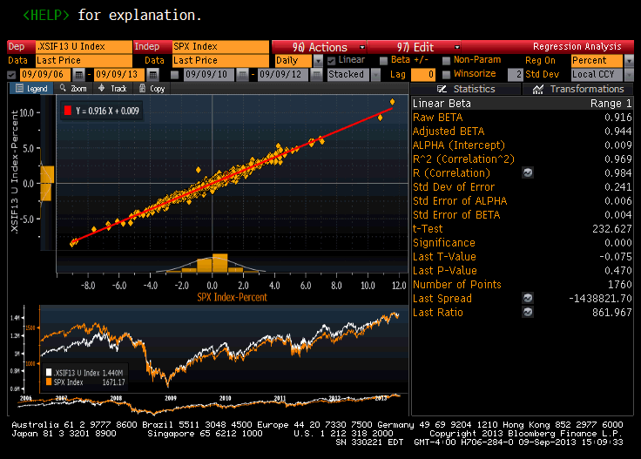
Basket Index Menu: .Name <Index>
To access the menu screen for a basket created in CIXB, type basket name and hit enter:
XSIF Fund: .XSIF13 <Index> <Enter>
HRA Screen

Slide 81
Bloomberg’s CORR Screen to Compute R²,
Alphas, and Betas for Stocks in a Portfolio
To create a CORR screen for the stocks of a portfolio created in PRTU:
Enter CORR <Enter>
Click “Create New” tab; select data time period
In the “Matrix Securities” box, unclick “Symmetric Matrix” button, import portfolio from “Add from Source” tab and click update
In Column Securities Box, add stock index (e.g., S&P 500) by typing index ticker and index moniker (e.g., SPX <Index>) and then click the “Next” tab; name your CORR Screen
On your portfolio’s CORR screen select the data time period for analysis and then use the Calculation tab to find each stock’s R², alphas, and betas.

Slide 82
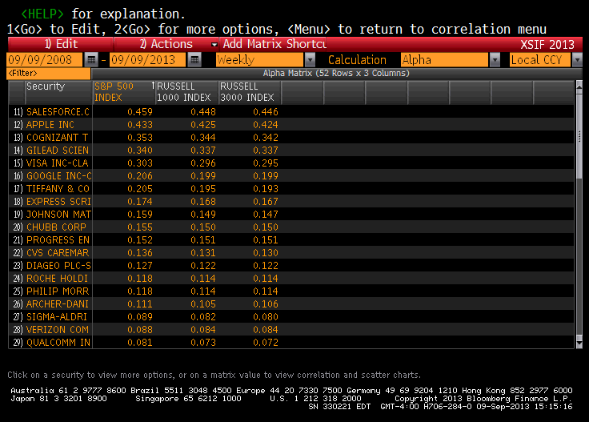
Bloomberg CORR Screen
The CORR Screen can be used to find the regression parameters for the stocks in a portfolio.
CORR screen for XSIF Fund Stocks
Regression alphas

Slide 83
Elton, Gruber, and Padberg
Technique for Determining the Best Efficient Portfolio

Slide 84
EGP Technique for
Determining the Optimum Portfolio
In a 1976 article, Elton, Gruber, and Padberg (EGP) showed how the single-index model can be extended to determine the best efficient portfolio (tangency point of the borrowing-lending line with the efficiency frontier).
The technique they derive for generating efficient portfolios, in turn, is much simpler than using the calculus minimization approach or quadratic programming.
Moreover, the approach can be set up with a constraint that weights are nonnegative.

Slide 85
EGP Technique for
Determining the Optimum Portfolio
The Elton, Gruber, and Padberg (EGP) algorithm starts by ranking each stock in the portfolio by its Treynor index, λ_{βj} (stock j’s risk premium per level of systematic risk as measured by the stock’s beta).
Next calculating an index C_{i} for a set of portfolios starting first with a one-security portfolio (i = 1) consisting of the security with the highest rank, λ_{β1}, then a two-security portfolio (i = 2) consisting of the first two securities with the highest ranks, λ_{β2}, and so on, with the final C_{i} calculation consisting of a portfolio of all the securities.
Columns 2 and 7 of the exhibit slide, “EGP Calculations Table” show respectively the λ_{βj} and the C_{i} formula and calculations for the portfolios formed with the 10-stock example.
Note that as you increase the size of the portfolio by adding the next higher ranked security to the portfolio, the C_{i} values increase until you get to portfolio with i = 4. After that point, adding each successive higher ranked stock reduces the value of C_{i}. The highest C_{i} is defined as the cutoff index and is denoted as C*. In this example, the cutoff index is C* = 10.8860.

Slide 86
EGP Technique for
Determining the Optimum Portfolio
Given the cutoff index, the next step is to select all securities with λ_{βj} > C* for inclusion in the portfolio.
With C* = 10.8860, there are four stocks in the example with λ_{βj} values exceeding C*.
The final step is to determine the portfolio allocations of each of the selected securities, w_{j}. Each security’s w_{j} is determined as a proportion of an index Z_{j} for the security to the sum of indexes for all securities in the portfolio.

Slide 87
EGP Technique for
Determining the Optimum Portfolio
10-Stock Portfolio Information

Slide 88
EGP Technique for Determining the Optimum Portfolio
EGP Calculations
Table

Slide 89
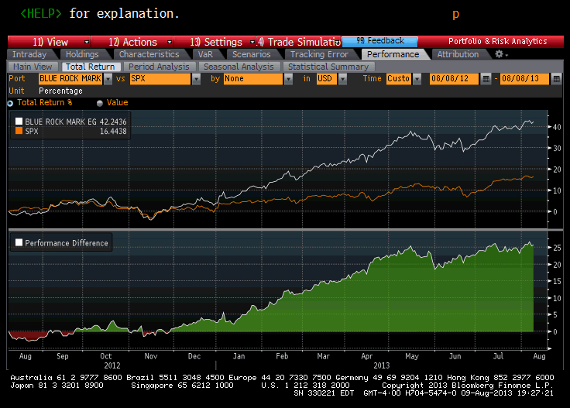
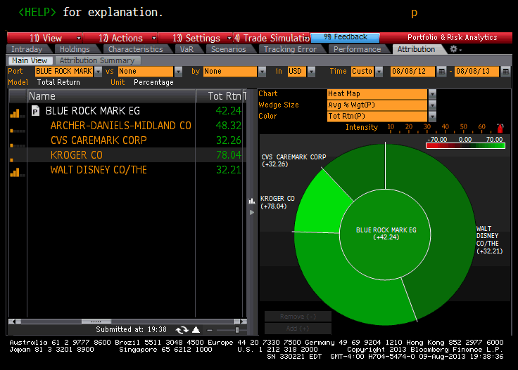
EGP Technique for Determining the Optimum Portfolio
The ex-post total returns from the one-year period from 8/8/12 to 8/8/13 for the Markowitz efficient portfolio (Blue Rock) using the EGP algorithm and the S&P 500 are shown in exhibit slide. (Bloomberg’s PORT screen, Performance tab, and Total Return tab).
The back testing results show the portfolio outperforms the market for the one-year period (total return of 42.24% compared to 16.44% for S&P 500).

Slide 90
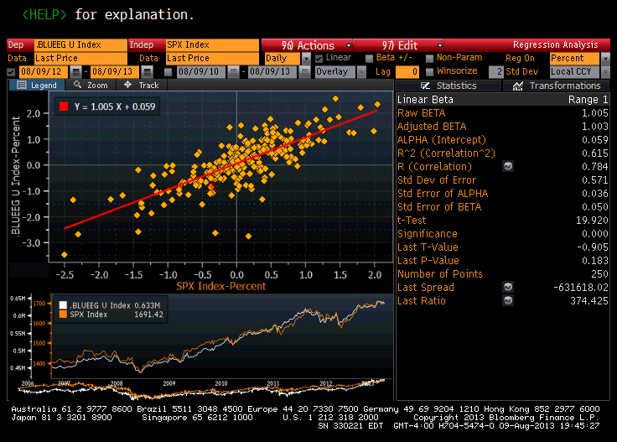
EGP Technique for Determining the Optimum Portfolio
A one-year regression of the portfolio against the S&P 500 (generated using the Bloomberg CIXB and HRA screens), shows the Markowitz portfolio has a beta close to one but a relatively large alpha of 0.059, indicating abnormal returns.

Slide 91
Bloomberg/Markowitz
Excel Program

Slide 92
Bloomberg/Markowitz Excel Program
A Markowitz Excel Program that determines portfolio allocations using the Elton, Gruber, and Padberg technique for a portfolio imported from the Bloomberg PRTU screen can be downloaded from the text’s Web site.
Using the “Markowitz” Excel program, one can import the names of the stocks from a portfolio created in PRTU into the program (see Bloomberg Exhibit Box: “Markowitz Excel Program”).
The user can then select a risk-free rate from a dropdown, an index (e.g., S&P 500 or Dow Jones), a regression time period, and a length of period (daily or weekly).
The program then calculates α_{i,} β_{i}, and V(ε_{i}), and then each stock’s E(r_{i}) and V(r_{i}), and λ_{βj} based on the index’s average market return and variability: E(R^{M}) = AvR^{M} and V(R^{M}) = AvV(R^{M}).
The user can also elect to use either Bloomberg’s adjusted beta or the regression beta (raw beta). Calculation Sheet 2 of the Excel program shows each stock’s parameter values in the order of their λ_{βj}’s and the Elton, Gruber, and Padberg parameter calculations of C_{i}, and optimum weights.

Slide 93
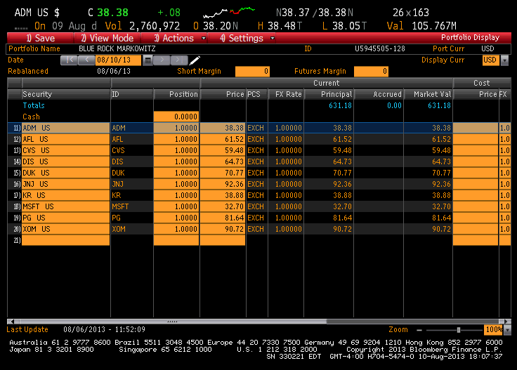
Bloomberg/Markowitz Excel Program
The exhibit slide shows (1) the Bloomberg PRTU slide of the illustrative 10-stock portfolio; (2) the input page of the Excel program where the S&P 500, 10-year Treasury, and a weekly time period from 8/5/2006 to 8/8/2013 were selected for the regressions, and (3) the Calculation Sheet 2, where the allocations for the portfolio are shown.
The portfolio consists of the same stocks as the optimizer program with high (but not identical) allocations to CVS, Disney, Kroger, and Johnson & Johnson.

Slide 94
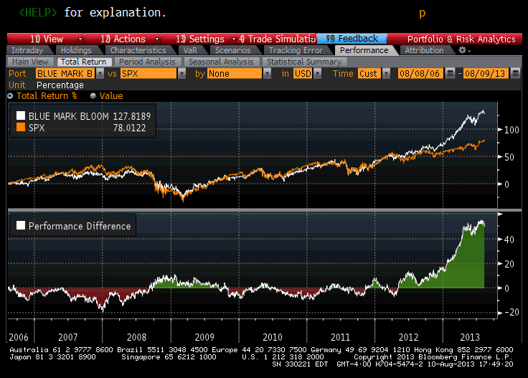
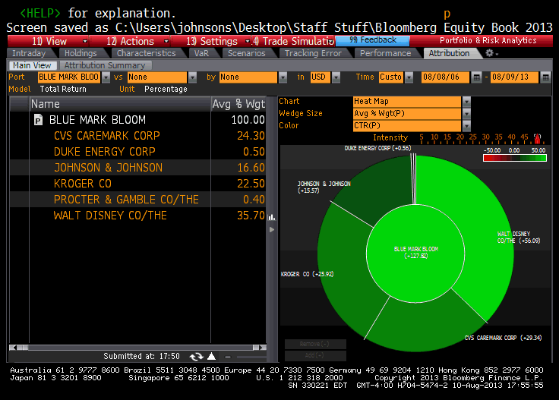
Bloomberg/Markowitz Excel Program
The exhibit shows the ex-post performance of the portfolio (named Blue Mark Bloom) relative to the S&P 500 for the 8/8/2006–8/19/2013 period.
The fund dramatically outperforms the market during this period with a total return for the period of 127.82% compared to a return of 78.01 for the S&P 500, with the most significant gains occurring in 2013.

Slide 95
Multi-Index Model

Slide 96
Multi-Index Models
The single-index model assumes that all stocks in the portfolio are related to only one factor, with that factor typically being the market return.
In a multi-index model, the number of factors affecting each security in the portfolio is extended to include more than one explanatory variable. Specifically, the model assumes that the return of each stock i in the portfolio being evaluated is related to the same set of factors, I_{ij}:
This model also assumes that the standard regression assumptions hold for each security (ε is normally distributed with E(ε) = 0, cov(ε_{i} I_{j}) = 0, and V(ε) is constant over observations), and that there is no correlation in the error terms for securities (cov(ε_{j} ε_{k}) = 0).

Slide 97
Multi-Index Models
Multi-index models vary in terms of the factors used to explain returns. For example, there are
  Industry models that explain stock returns in terms of the market and the average returns of the stock's industry
  Pseudo industry models in which the indices are formed from stocks grouped into categories such as growth, cyclical, and stable
  Macroeconomic models in which factors such as the market return, inflation, and bond returns explaining each stock's return
Empirical research has provided evidence that provides some support for the construction of multi-index models based on macroeconomic factors that affect the value of stock as measured by the present value of the stock's future cash flows.

Slide 98
Multi-Index Models
In a multi-index model, the number of computations needed to determine an optimal portfolio is greater than the computations needed for the single-index model but less than the requirements needed using historical averages.
To see this, consider the inputs needed to determine a n-stock portfolio return and risk in which the securities are explained by the following two-index model
    Where:

Slide 99
Multi-Index Models
The stock expected returns, variances, and covariances for this model are
For an n-stock portfolio, one would need to estimate n α's, n β_{i1}'s, n β_{i2}'s, and n V(ε_{i})'s, along with estimating E(I­₁), E(I₂), V(I₁), V(I₂), and cov(I₁ I₂).
As the number of indexes increases, the more coefficients and variables must be estimated.

Slide 100
Multi-Index Models
A problem with multi-index model is the possibility that the explanatory variables in a multiple regression model could be linearly related—a condition referred to as multicolinearity.
When multicolinearity exists, one of the variable is redundant (i.e., it is simply a linear transformation of the other), and the regression qualifiers (t-test and F-test) are biased. As a result, the quality of the regression cannot be determined.

Slide 101
Multi-Index Models
The problems of number of computations and multicollinearity can be minimized by converting the mult-index model's equation into another multi-index model in which the indexes, I*, are uncorrelated; that is, where
Procedures for converting multi-index models into ones with uncorrelated indices are presented in many statistics books.
Elton and Gruber have derived a simplified technique for generating the best efficient portfolio using a multi-index model. See: Elton, Gruber, Brown, and Goetzmann (2003).

Slide 102
Case: Portfolio Construction using
Bloomberg/Markowitz Excel Program

Slide 103
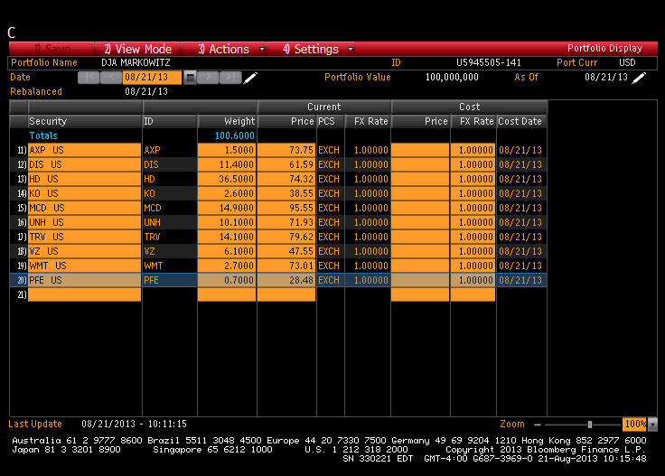
Case: Bloomberg/Markowitz Excel Program
Step 1: Construct a portfolio in PRTU consisting of one share in each of the DJIA stocks:
PRTU <Enter>
Click red “Create”
From Settings Screen, click “Import”
From “Actions” tab, select “Equity Index” from “Source” dropdown and INDU from “Name” dropdown.

Slide 104
Case: Bloomberg/Markowitz Excel Program
Step 2: Use the Markowitz Excel program to determine the best efficient portfolio using the Elton, Gruber, and Padberg, algorithm box: “Markowitz Excel Program.”
The Markowitz portfolio shown in this box used the time period from 2008 (just after the market crash) to the 8/8/2013, the S&P 500 as the market index, weekly periods for data calculations, and the 10-year Treasury for the risk-free security.
The Excel program generates expected returns on eachstock: E(r_{i}) = α + βE(R^{M}), where E(R^{M}) is based on the average on the index for the time period selected. The stock variances are V(r_{i}) = β²V(R^{M}) + V(ε), where V(R^{M}) is also based on the historical average variability of the index for the time period selected.

Slide 105
Case: Bloomberg/Markowitz Excel Program
Step 3: Create a Markowitz portfolio in PRTU.
In constructing the portfolio, use fixed weights:
PRTU <Enter>
Click red “Create” tab
From Settings Screen click “Fixed Weight” in the “Position” box
On the stock input screen enter the Markowitz weights
PRTU

Slide 106
Case: Bloomberg/Markowitz Excel Program
Step 4: Create history for the Markowitz portfolio:
Bring up the PRTU screen for your portfolio.
On the screen, change the date in the amber “Date” box (e.g. Month/Day/2006).
Click the “Edit” tab and then the “Actions” tab.
From the “Actions” dropdown, select “Import” to bring up the import box.
On the import box, select “Portfolio” from the “Source” dropdown, the name of your portfolio from the “Name” dropdown, change the date (e.g., back to the current period), and then hit the “Import” tab. You should now have a portfolio with historical data.

Slide 107
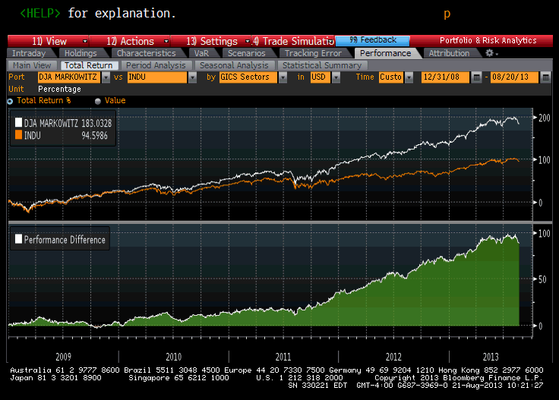
Case: Bloomberg/Markowitz Excel Program
Step 5: Analyze the portfolio’s performance relative to the DJA in PORT: PORT <Enter>,
Select “INDU” for comparison
Click Performance tab, Total Return tab, and select time period for analysis (e.g. 12/31/2008 to 8/20/13)

Slide 108
Other Bloomberg Portfolio Screens

Slide 109
Other Bloomberg Portfolio Screens
PORT's Trade Simulation Tab
This tab on PORT allows you to select and edit hypothetical trading positions for your portfolio to assess the impact these moves may have on your portfolio.
You can save and modify these portfolios at a later date.

Slide 110
Other Bloomberg Portfolio Screens
PORT’s VAR Tab: Value-at-Risk:
VAR displays value at risk analytics for a portfolio.
One can select from the tabs Absolute VAR/ Relative VAR (relative to a benchmark) from the toolbar to display the desired data.
The VAR calculation is based on the following Methodologies: Historical 1 year, Historical 2 year, Historical 3 year, Monte Carlo, or Parametric.
VAR is based on a given Confidence Interval (95%, 97.5%, or 99%), and a given Time Horizon (between 1 day and 1 quarter) and shows the range of possible values of the portfolio, industry, stocks, and index.

