Slide 1
Motivation at Work

Slide 2
Define motivation.
Explain how Theory X and Theory Y relate to Maslow’s hierarchy of needs.
Discuss the needs for achievement, power, and affiliation.
Describe the two-factor theory of motivation.
Notes:
Learning Objectives
- Define motivation.
- Explain how Theory X and Theory Y relate to Maslow’s hierarchy of needs.
- Discuss the needs for achievement, power, and affiliation.
- Describe the two-factor theory of motivation.

Slide 3
5 Explain two new ideas in human motivation.
6 Describe how inequity influences motivation and can be resolved.
7 Describe the expectancy theory of motivation.
8 Describe the cultural differences in motivation.
Notes:
Learning Objectives continued
- Explain two new ideas in human motivation.
- Describe how inequity influences motivation and can be resolved.
- Describe the expectancy theory of motivation.
- Describe the cultural differences in motivation.

Slide 4
Motivation and Work Behavior
Motivation: the process of arousing and sustaining goal-directed behavior
Motivational theories attempt to explain and predict observable behavior
Internal
External
Process
Notes:
Motivation is the process of arousing and sustaining goal-directed behavior. Motivation theories attempt to explain and predict observable behavior, and may be classified as internal, process, or external theories

Slide 5
Motivation Theories
Internal
Process
External
Give primary consideration to variables within the individual
Emphasize the nature of the interaction between the individual and the environment
Focus on the elements in the environment
Notes:
Motivation Theories
This is one of the most complex topics in organizational behavior because of the large number of variables that affect motivation.

Slide 6
Internal Needs
Max Weber
Work contributes to salvation
Protestant work ethic
Sigmund Freud – Psychoanalysis
Delve into the unconscious mind to better understand a person’s motives and needs
Notes:
Internal Needs
Motivation research is increasingly specific, and examines smaller portions of the larger theories. Writers have looked for internal, value-oriented reasons for motivation that would relate to the meaning of work for society. The Protestant ethic was related to the concept of working hard in order to secure a place in heaven. In contrast, Freud developed psychoanalysis as a method of probing the subconscious mind to understand a person’s motives and needs.

Slide 7
External Incentives
Adam Smith
Enlightened self-interest; people are motivated by self-interest for economic gain
Technology is a force multiplier for labor productivity
Frederick Taylor
Founder of scientific management
Emphasized cooperation between management and labor to enlarge profits
Notes:
External Incentives
Early scholars assumed that self-interest and economic gain motivated people. Self-interest refers to seeking one’s own best interest and benefit. Early theories of motivation typically took one of two perspectives. The first was that people acted out of self-interest for material gain; the second suggested that people act in ways that satisfy their emotional needs. Adam Smith's basic assumption was that people are motivated by self-interest for economic gain, and he concluded that employees would be most productive when motivated by self-interest. Frederick Taylor believed that the conflict between management and employees was over how to divide profits.

Slide 8
Employee Recognition and Ownership
These modern management practices build on Smith’s and Taylor’s original theories:
  Employee recognition programs
  Flexible benefit packages
  Stock ownership plans
These practices emphasize external incentives
Psychological ownership increases organizational citizenship behavior
Notes:
Employee Recognition and Ownership
Modern management practices like employee recognition programs, flexible benefit packages, and stock ownership plans build on Smith’s and Taylor’s original theories. Scholars and managers increasingly emphasize the importance of psychological ownership as a means of increasing organizational citizenship behavior.

Slide 9
Maslow’s Hierarchy of Needs
Theory of motivation based on a hierarchy of needs
Five need categories:
  Physiological needs
  Safety and security needs
  Love (social) needs
  Esteem needs
  Self-actualization
Notes:
The Hierarchy of Needs
Maslow divided human motivation into a needs hierarchy consisting of five levels of needs to be satisfied, and suggested that as people satisfy needs on one level, they progress to the next level of need as motivation for behavior. According to Maslow, only ungratified needs motivate behavior and it is always the lowest level of ungratified needs in the hierarchy that takes precedence.

Slide 10
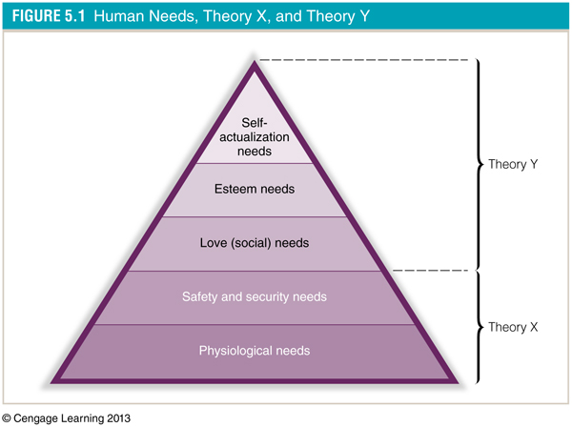
Notes:
The Hierarchy of Needs Figure 5.1

Slide 11
Theory X and Theory Y
SA
Esteem
Theory Y
Love (Social)
Safety & Security
Theory X
Physiological
Notes:
Theory X and Theory Y
McGregor utilized the needs hierarchy to develop polarized assumptions about workers based on whether they are motivated by lower order needs or by higher order needs. Furthermore, he suggested that individuals in organizations should be treated differently depending on which level of needs motivated them. Theory X represents the assumptions associated with managing individuals motivated by lower order needs. Theory Y represents the assumptions associated with managing individuals motivated by higher order needs.

Slide 12
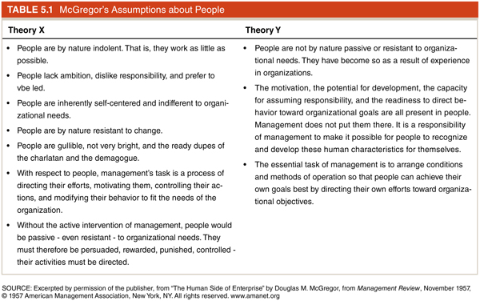
Notes:
Theory X and Theory Y Table 5.1

Slide 13
Alderfer’s ERG Theory
Groups human needs into only three basic categories:
  Existence
  Relatedness
  Growth
Regression hypothesis states that people regress to the next lower category
Notes:
ERG Theory
ERG theory represents a reclassification of Maslow's need hierarchy into three levels of needs. Alderfer also developed a regression hypothesis that suggests individuals will regress to lower levels of need when they experience frustration in attempting to satisfy higher level needs.

Slide 14
ERG Classifications
SA
Growth
Esteem
Love (Social)
Relatedness
Safety & Security
Existence
Physiological
Notes:
ERG Classifications

Slide 15
McClelland’s Need Theory
Manifest needs: learned or acquired needs
Achievement
Excellence, competition, challenging goals, persistence, overcoming difficulties
Power
Make an impact, influence others, change people or events, make a difference
Affiliation
Establishing and maintaining warm, close, intimate relationships with others
Notes:
McClelland's need theory focuses on personality and learned needs. He categorized motives into three manifest needs: need for achievement, need for affiliation, and need for power.
A. Need for Achievement
The need for achievement refers to seeking excellence in performance, competition, challenging goals, persistence, and overcoming difficulties. Research indicates that people with a high need for achievement outperform those with a moderate or low need for achievement.
B. Need for Power
The need for power is concerned with making an impact on others, influencing others, changing people or events, and making a difference in life. McClelland further distinguished between socialized power (used for the benefit of many) and personalized power (used for personal gain).
C. Need for Affiliation
The need for affiliation emphasizes the establishment and nurturing of intimate relationships with other people. In contrast, individuals with a high need for autonomy, as outlined in Murray’s manifest needs theory, value independence and freedom from constraints. Students may be able to identify the differences between individuals by using an example of telecommuting and by discussing which individual would be more comfortable with this change in organizational interaction.

Slide 16
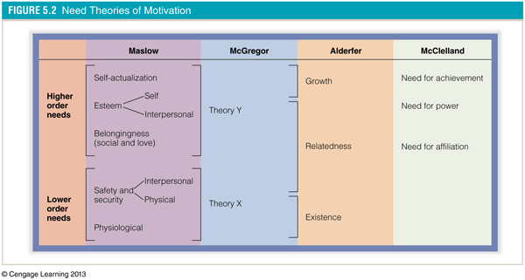
Notes:
Need Theories of Motivation

Slide 17
Herzberg’s Two-Factor Theory
Examined the experiences that satisfied or dissatisfied people at work
Motivation factors: work conditions related to satisfaction of the need for psychological growth
Hygiene factors: work conditions related to dissatisfaction caused by discomfort or pain
Notes:
The two-factor theory examines the degree to which individuals are satisfied or dissatisfied at work. Herzberg's theory provided two lists of needs. For example, work conditions related to satisfying psychological growth needs were labeled motivation factors. On the other hand, work conditions related to dissatisfaction caused by discomfort or pain were labeled hygiene factors.

Slide 18
Motivation-Hygiene Theory
Company policy and
administration
Supervision
Interpersonal relations
Working conditions
Salary
Status
Security
Motivation factors
increase
job satisfaction
Achievement
Achievement recognition
Work itself
Responsibility
Advancement
Growth
Salary?
Hygiene factors
avoid
job dissatisfaction
Notes:
A. Motivation Factors
Motivation factors include responsibility, achievement, recognition, advancement, and the work itself. When present, these factors lead to superior performance and effort on the part of employees. The absence of these factors leads to a lack of satisfaction, but does not lead to dissatisfaction.
B. Hygiene Factors
Hygiene factors include company policies and administration, technical supervision, salary, interpersonal relations with supervisor, working conditions, and status. Job dissatisfaction occurs when the hygiene factors are either not present or not sufficient. However, because they cannot stimulate psychological growth, their presence does not lead to satisfaction.
C. Critique of the Two-Factor Theory
Although the approaches of Maslow and Herzberg were more flexible than previous theories, critics identify the lack of clear distinction between hygiene and motivation factors, the absence of individual differences, and the absence of intrinsic motivators as deficiencies. History is full of examples of people who are motivated by causes, personal missions, discovery, service, beliefs, creativity, and other factors not considered by Herzberg.

Slide 19
Eustress, Strength, and Hope
Eustress: healthy, normal stress
Focuses on the individual’s interpretation of events rather than needs, rewards, or punishments
New, positive perspective on organizational life
  Invest in strengths
  Find positive meaning in work
  Display courage and principled action
  Draw on positive emotions
Notes:
Eustress, Strength, and Hope
Eustress is the positive side of stress that is healthy and normal. Rather than focusing on individuals’ needs or rewards and punishments, this new positive perspective focuses on individuals’ interpretations of events.

Slide 20
Positive Energy and Full Engagement
Management of energy rather than time
Strategic use of disengagement to balance the power of full activity engagement
Physical
Emotional
Mental
Spiritual
Energy
Notes:
Positive Energy and Full Engagement
The positive energy and full engagement approach takes lessons learned from professional athletes and applies them to the corporate setting. According to this view, the manager’s task is to help individuals learn to manage their energy so that they can experience periodic renewal and recovery and thus build positive energy and capacity for work.

Slide 21
Social Exchange and Equity Theory
Equity theory: a social exchange process theory of motivation that focuses on individual-environment interaction
Concerned with social processes that influence motivation and behavior
Etzioni’s exchange relationships:
  Committed
  Calculated
  Alienated
Notes:
Social exchange and equity theory revolve around the balance between efforts and rewards in organizations. The individual-organization exchange relationship addresses the contributions and demands that each party makes in the relationship.

Slide 22
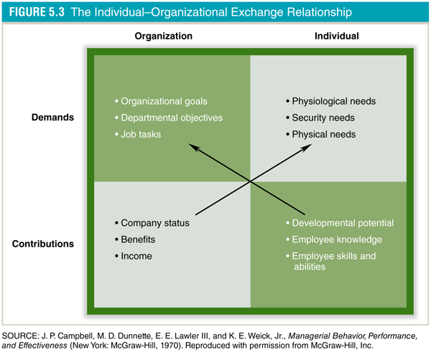
Notes:
Demands. Needs form the basis for the expectations or demands placed on organizations by individuals. Organizations express demands on individuals through job expectations, mission statements, and performance feedback.
Contributions. Contributions are the basis for satisfying the demands expressed by the other party in the relationship. Individual contributions include knowledge, skills, abilities, and professional contacts. Organizational contributions include status, benefits, income, and affiliation.

Slide 23
Adam’s Theory of Inequity
Suggests inequity or unfairness motivates people more than equity or fairness
Inequity
Tension
Motivation to Act
Notes:
Adams developed a theory of social exchange that analyzes inequity in the workplace. Individuals calculate an outcome/input ratio for themselves and compare it with an outcome/input ratio for a comparable other person. Inequity is the situation in which individuals perceive that their own outcome/input ratio is greater or less than the comparison other’s outcome/input ratio. When individuals perceive that a situation of inequity exists, they take action to restore equity (i.e., make their own outcome/input ratio equal to the comparison other’s outcome/input ratio).

Slide 24
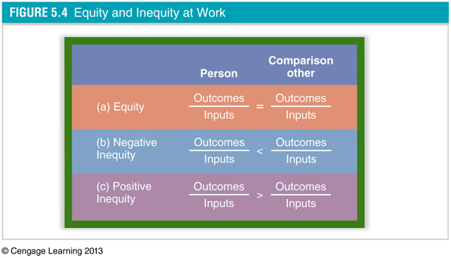
Notes:
Equity and Inequity at Work

Slide 25
The Resolution of Inequity
Alter the person’s outcomes
Alter the person’s inputs
Alter the comparison other’s outcomes
Alter the comparison other’s inputs
Change who is used as a comparison other
Rationalize the inequity
Leave the organizational situation
Notes:
Individuals seek to resolve inequity because it produces tension. The seven strategies for restoring equity are (1) alter the person's outcomes, (2) alter the person's inputs, (3) alter the comparison other's outcomes, (4) alter the comparison other's inputs, (5) select a different comparison other, (6) rationalize the inequity, and (7) leave the organizational situation.

Slide 26
New Perspectives on Equity Theory
Equity sensitives
Prefer equity based on the original theory
Benevolents
Entitleds
Comfortable with an equity ratio less than that of comparison other
Comfortable with an equity ratio greater than that of comparison other
Notes:
New Perspective on Equity Theory

Slide 27
Vroom’s Expectancy Theory of Motivation
Valence: value or importance placed on a reward
Expectancy: belief that effort leads to performance
Instrumentality: belief that performance is related to rewards
Expectancy and instrumentality
concern a person’s beliefs about
how effort, performance, and
rewards are related
Notes:
Expectancy theory is a cognitive process theory of motivation that includes three key constructs: valence, expectancy, and instrumentality. Valence is the value or importance an individual places on a particular reward. Expectancy is the belief that effort will lead to performance. Instrumentality is the belief that performance is related to rewards.

Slide 28
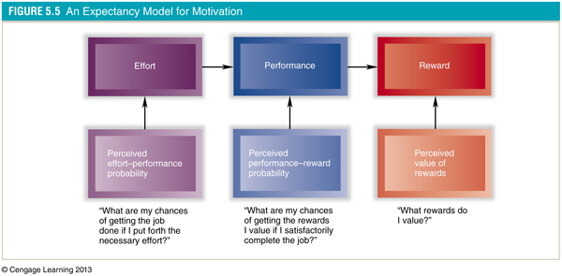
Notes:
Expectancy theory is based on personal perceptions of the performance process and the idea that people desire certain outcomes for behavior, and that they believe there are connections between effort, performance, and outcomes.

Slide 29
Motivational Problems
Motivational problems
Disbelief in a relationship between effort and performance
Disbelief in a relationship between performance and rewards
Lack of desire for the rewards offered
Notes:
Motivation problems stem from three basic causes within the expectancy theory framework. These causes are a disbelief in a relationship between effort and performance, failure to perceive a clear relationship between performance and rewards, and lack of desire for the rewards offered.

Slide 30
Expectancy Theory and Moral Maturity
Expectancy theory would predict that people work to maximize their personal outcomes
Expectancy theory could not explain or predict altruistic behavior for the benefit of others
Therefore, it may be necessary to consider an individual’s moral maturity in order to better understand altruistic, fair, and equitable behavior
Notes:
Expectancy theory is grounded in the concept of self-interest, and does not explain motivations that may be altruistic. Moral maturity is the measure of a person's cognitive moral development that aids in explaining motivation for altruistic pursuits.

Slide 31
Cultural Differences
Most motivation theories in use today have been developed by, practiced by, and tested among Americans
Motivational theories are culturally bound
Research results differ across cultures
Notes:
With regard to Maslow’s, McClelland’s, Herzberg’s, and Vroom’s theories, differences have been found in different cultures’ reactions to motivational techniques.

Slide 32
Many Ways to Motivate People
Training
Coaching
Task assignments
Rewards contingent on good performance
Valued rewards offered
Sensitivity to inequities
Notes:
Many Way to Motivate People
- Training
- Coaching
- Task assignments
- Rewards contingent on good performance
- Valued rewards offered
- Sensitivity to inequities

Slide 33
Friday Night Lights Video Clip
This chapter defined motivation as “the process of arousing and sustaining goal-directed behavior.” Does Mike Winchell show the characteristics of this definition early in the scene? Do you expect him to show any of the characteristics after the scene ends and he returns to the team?
Which needs discussed earlier in this chapter does Mike appear focused on early in the scene? Which needs can become his focus later in the scene? See “The Hierarchy of Needs” and “ERG Theory” sections earlier in this chapter for some suggestions.
Apply “McClelland’s Need Theory” to this scene. Which parts of that theory appear in this scene? Give specific examples.

